Slide 1
Bayesian Optimization
When we fit a model, we rely on finding the minimum of the associated cost function.

Slide 2
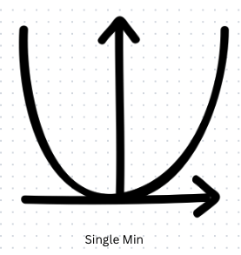
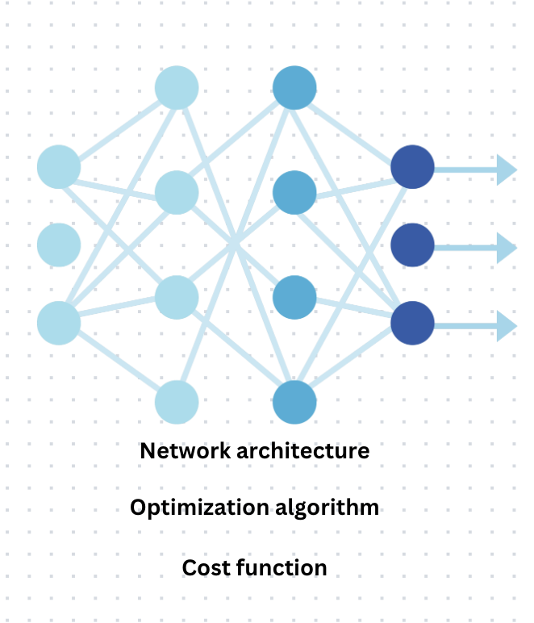
Optimization problems
Simple: Cost function for a logistic regression model is closed-form derivatives so any sensible gradient-based method will find the minimum.
Challenging: Hyperparameter search. Before we train the network, we must define them.

Slide 3
What is the Gradient?
The gradient is a vector that contains all the partial derivatives of a function with respect to its input variables. In simple terms, it shows the direction and rate of the steepest increase of the function.
Each component of this vector tells us how much the function will change if we tweak that particular parameter.

Slide 4
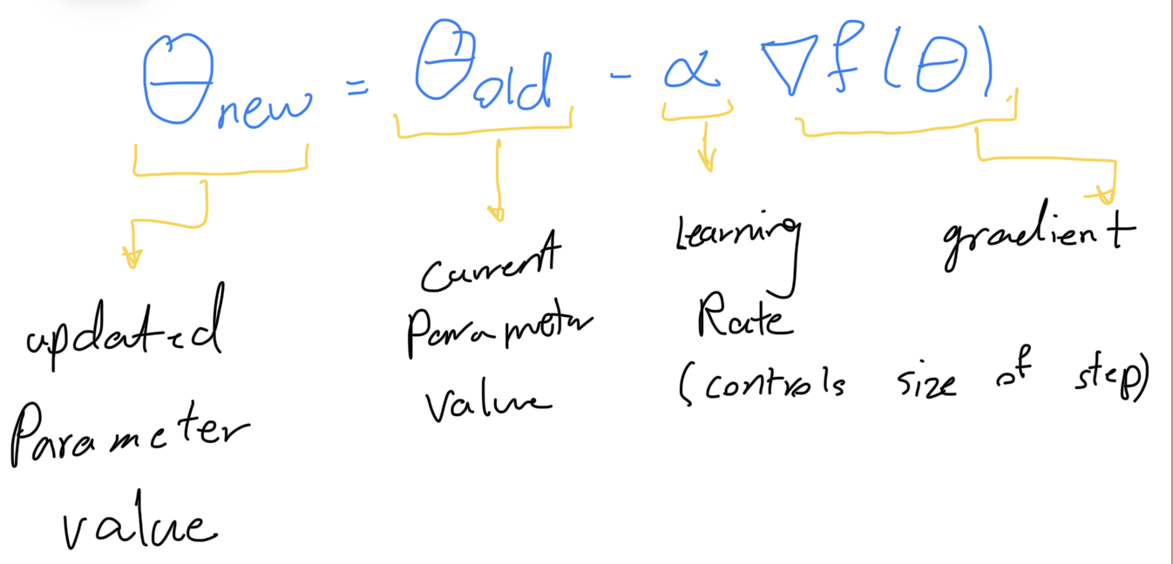
Traditional gradient-based way method:
The goal of training a model is to find the set of parameters that minimize the cost function. The gradient points in the direction of the steepest ascent (increase) of the function, but since we want to minimize the cost, we move in the opposite direction of the gradient—this is known as gradient descent.
In gradient descent, the parameters are updated iteratively using:

Slide 5
Challenges:
Evaluation cost: Evaluating the function that we wish to maximize is very expensive.
Multiple local optima
Variable types: There are a mixture of discrete variables and continuous variables.
Conditional variables
Noise: The function may return different values for the same input hyperparameter set.
No derivatives: We do not have access to the gradient of the function

Slide 6
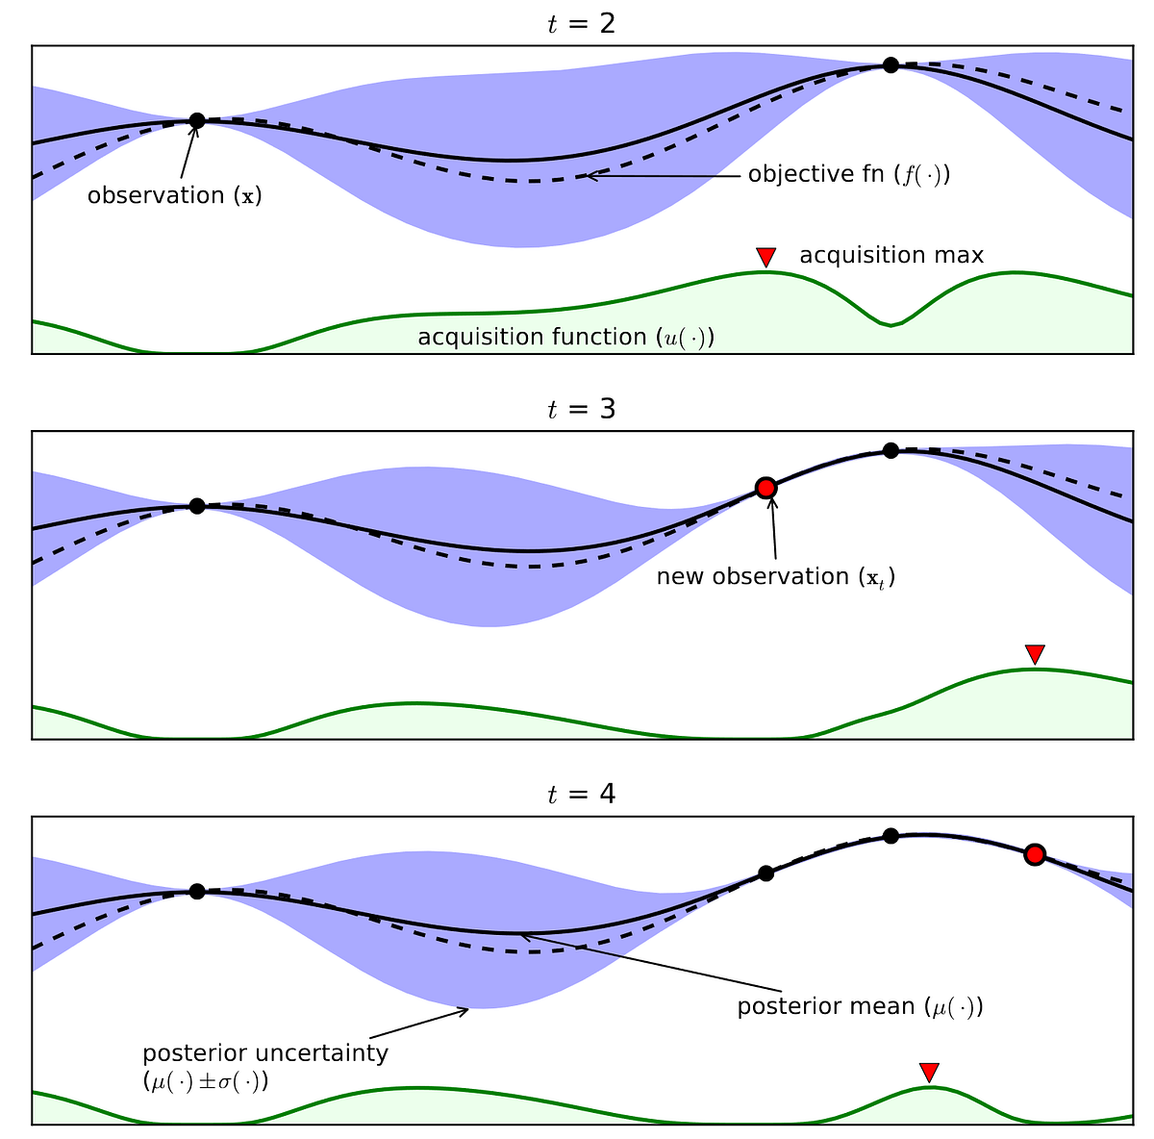
Bayesian optimization is a framework that can deal with optimization problems that have all of these challenges

Slide 7
Core Idea of Bayesian Optimization:
Modeling the Function: Bayesian optimization does not directly optimize the function by adjusting parameters in the traditional gradient-based way. Instead, it builds a probabilistic model that approximates the function we are trying to optimize. This model captures our current understanding of the function’s behavior based on observed data (previous evaluations).
Estimate and Uncertainty: The model not only predicts the expected performance but also quantifies the uncertainty of this estimate.
These allow Bayesian optimization to make informed decisions about where to explore next.

Slide 8
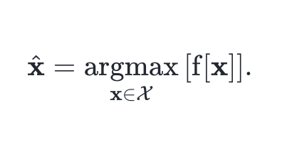
Problem setup
At iteration t, the algorithm can learn about the function by choosing parameters xt and receiving the corresponding function value f[xt].
we want to minimize the number of iterations t before we can guarantee that we find parameters x^ such

Slide 9
Let's Bake For the first time
We’ll assume for now that all parameters are continuous, that their existences are not conditional on one another, and that the cost function is deterministic so that it always returns the same value for the same input.

Slide 10
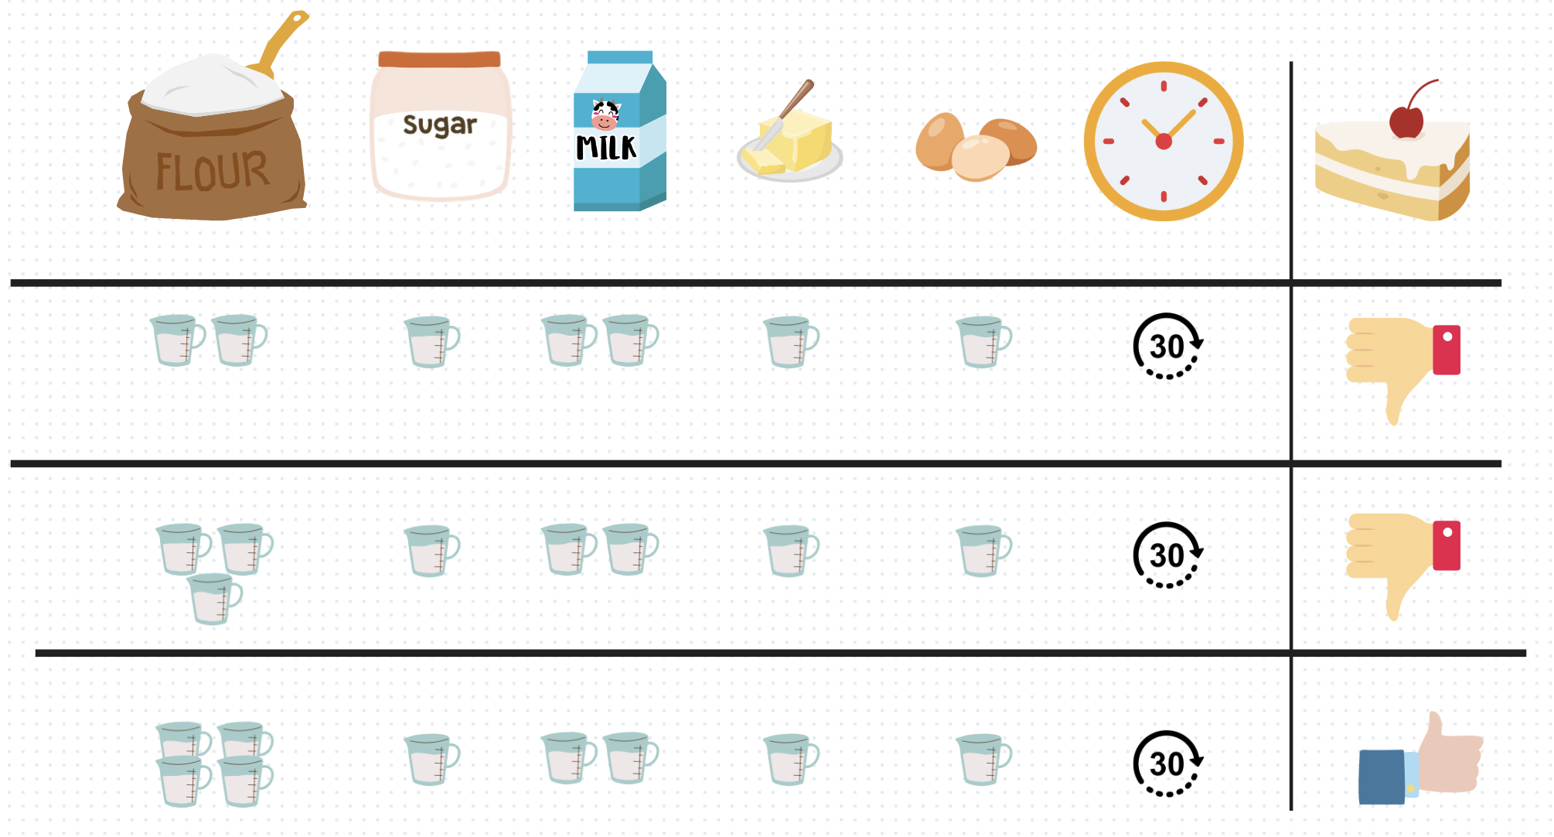
Grid Search
x
Grid Search is a straightforward method where you divide each parameter’s possible values into discrete points, forming a grid.
This is simple and easily parallelizable but suffers from the curse of dimensionality; the size of the grid grows exponentially in the number of dimensions.

Slide 11
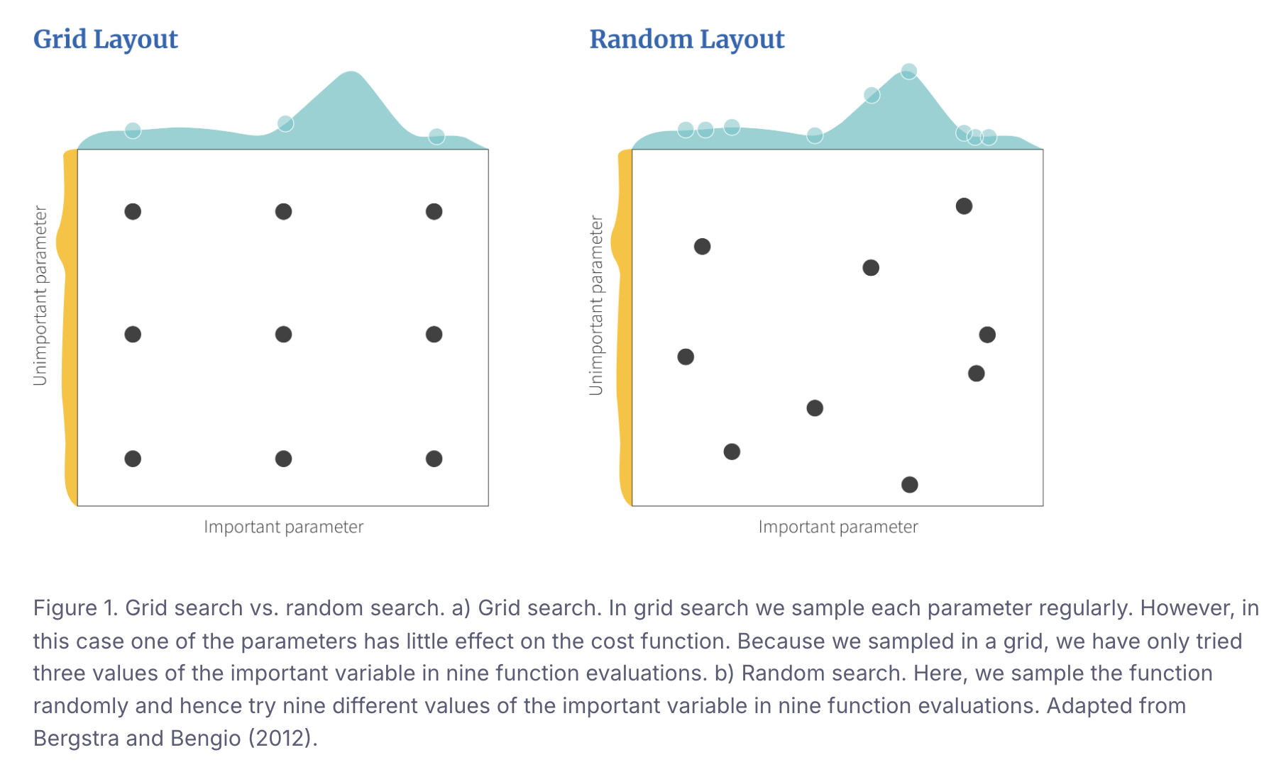
Random Search
Another strategy is to specify probability distributions for each dimension of x and then randomly sample from these distributions
This addresses the inefficiency of grid search that occurs when one of the parameters has very little effect on the function output. Random search is also simple and parallelizable. However, if we are unlucky, we can may either (i) make many similar observations that provide redundant information, or (ii) never sample close to the global maximum.

Slide 12
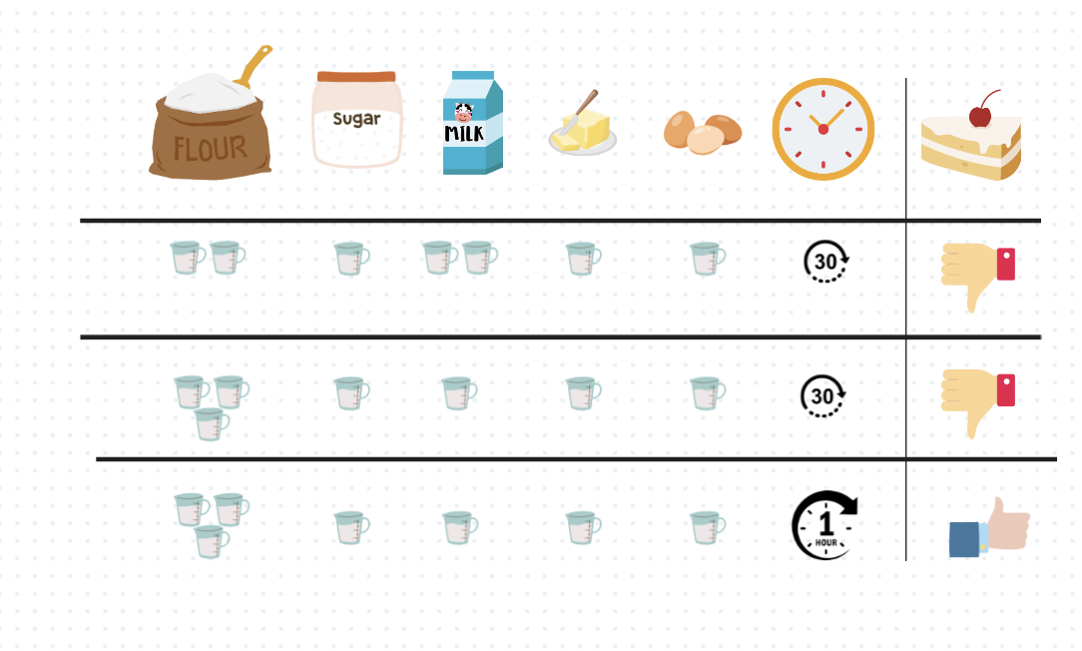
Sequential search strategies
Obvious deficiency of both grid and random search is that they do not consider previous measurements.
If the measurements are made sequentially then we could use the previous results to decide where it might be strategically best to sample next. One idea is that we could explore areas where there are few samples so that we are less likely to miss the global maximum entirely. Another approach could exploit what we have learned so far by sampling more in relatively promising areas. An optimal strategy would recognize that there is a trade-off.

Slide 13
Which one is better for the next sample? x1 or x2?

Slide 14
Which one is better for the next sample? x1 or x2?
The best strategy depends on the underlying function (which we don’t know).
x1 is a good place to sample because the function will probably return a high value here, and x2 is a good place to sample because the uncertainty here is very large.

Slide 15
imagine You’re Trying to Find the Best Recipe:
Starting with a Guess (Prior):
Imagine you want to make the best chocolate chip cookies, but you don’t know the best amounts of ingredients like flour, sugar, and butter.
You start with a guess (this is called the “prior”). Your guess might be random or based on general knowledge (like a basic cookie recipe), but you’re not sure if it’s the best because you haven’t tried it yet. This guess represents a very uncertain starting point because you haven’t done any baking yet.
Testing and Learning (Updating the Model):
You bake a batch of cookies with your initial guess of ingredients and see how they taste. Based on this result, you now have some knowledge of how the recipe performs.
This new information updates your understanding of the recipe—this updated understanding is called the “posterior.” It’s more accurate than your starting guess because it’s based on real feedback from tasting the cookies.
Balancing Where to Test Next (Acquisition Function):
Now, you have to decide: should you try something similar to your last batch because it was pretty good (this is called “exploitation”)? Or should you try a completely different combination of ingredients to see if you can discover something even better (“exploration”)?
The acquisition function helps you decide. It tells you which recipe changes are worth trying next, balancing between tweaking what’s already good and experimenting with new ideas.
Finding the Best Recipe Efficiently:
Instead of just guessing randomly or trying every single combination, you’re making smart, informed decisions based on what you’ve learned so far.

Slide 16
Bayesian optimization
is a sequential search framework that incorporates both exploration and exploitation
main components:
A probabilistic model of the function: Bayesian optimization starts with an initial probability distribution (the prior) over the function f[∙] to be optimized. Usually this reflects the fact that we are extremely uncertain about what the function is. With each observation of the function (xt,f[xt]), we learn more and the distribution over possible functions (now called the posterior) becomes narrower.
An acquisition function: This is computed from the posterior distribution over the function and is defined on the same domain. The acquisition indicates the desirability of sampling each point next and depending on how it is defined it can favor exploration or exploitation.

Slide 17
Why it Works?
It’s beyond the scope of this session.

Slide 19
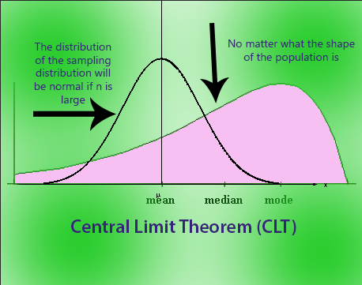
Central limit Theorem
It says the sampling distribution of the mean will always be normally distributed, as long as the sample size is large enough

Slide 20
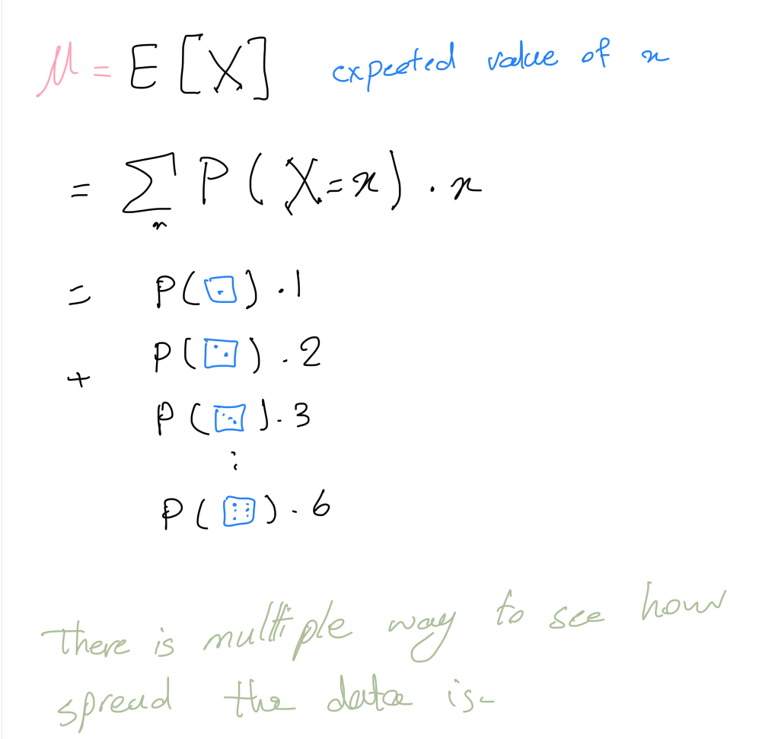
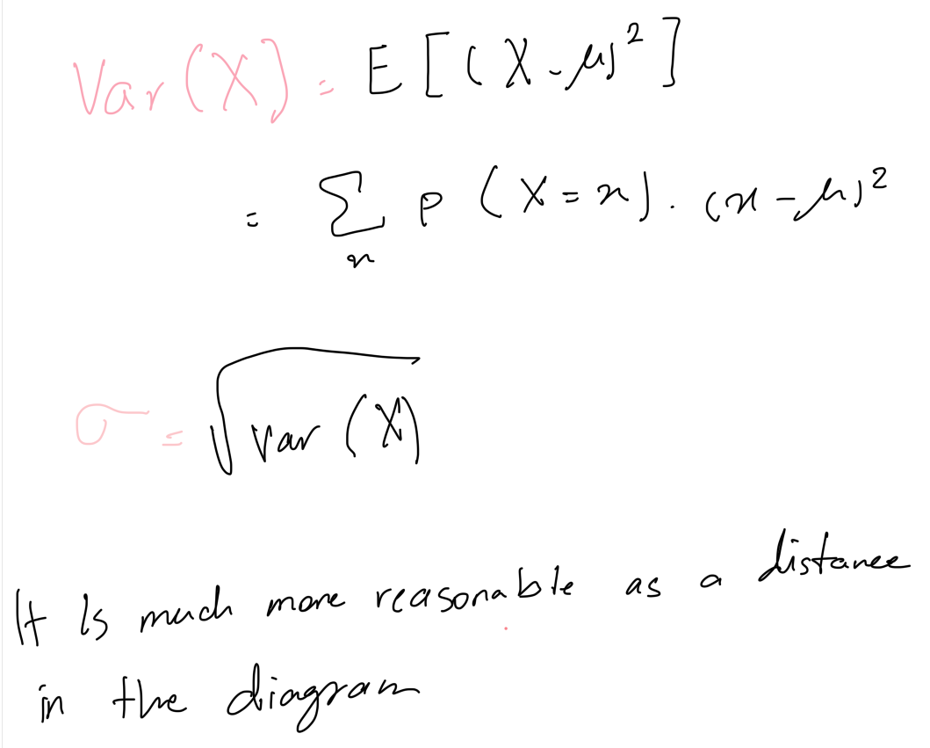

Slide 22
"A Gaussian Process is a collection of random variables, where any finite number of these are jointly normally distributed."
It's like saying, "if I pick a few numbers out of this group, they will behave predictably like a bell curve."
Notes:
This means a Gaussian Process (GP) is like a group of random numbers (or variables). These numbers follow a normal distribution (think of the bell curve) and, importantly, any small subset of these numbers also follows this normal distribution. It's like saying, "if I pick a few numbers out of this group, they will behave predictably like a bell curve."

Slide 23
A GP is described by two things:
Mean function m[x]: This tells us what the average (expected) value of the function at any point x should be.
Covariance function k[x, x']: This measures how similar two points x and x′ are. If x and x′ are close together, they should behave similarly (high covariance), and if they're far apart, they behave differently (low covariance).

Slide 24
example

Slide 26
Example for clarification
Predicting the temperature for 1.5 pm based on the known temperature

Slide 27
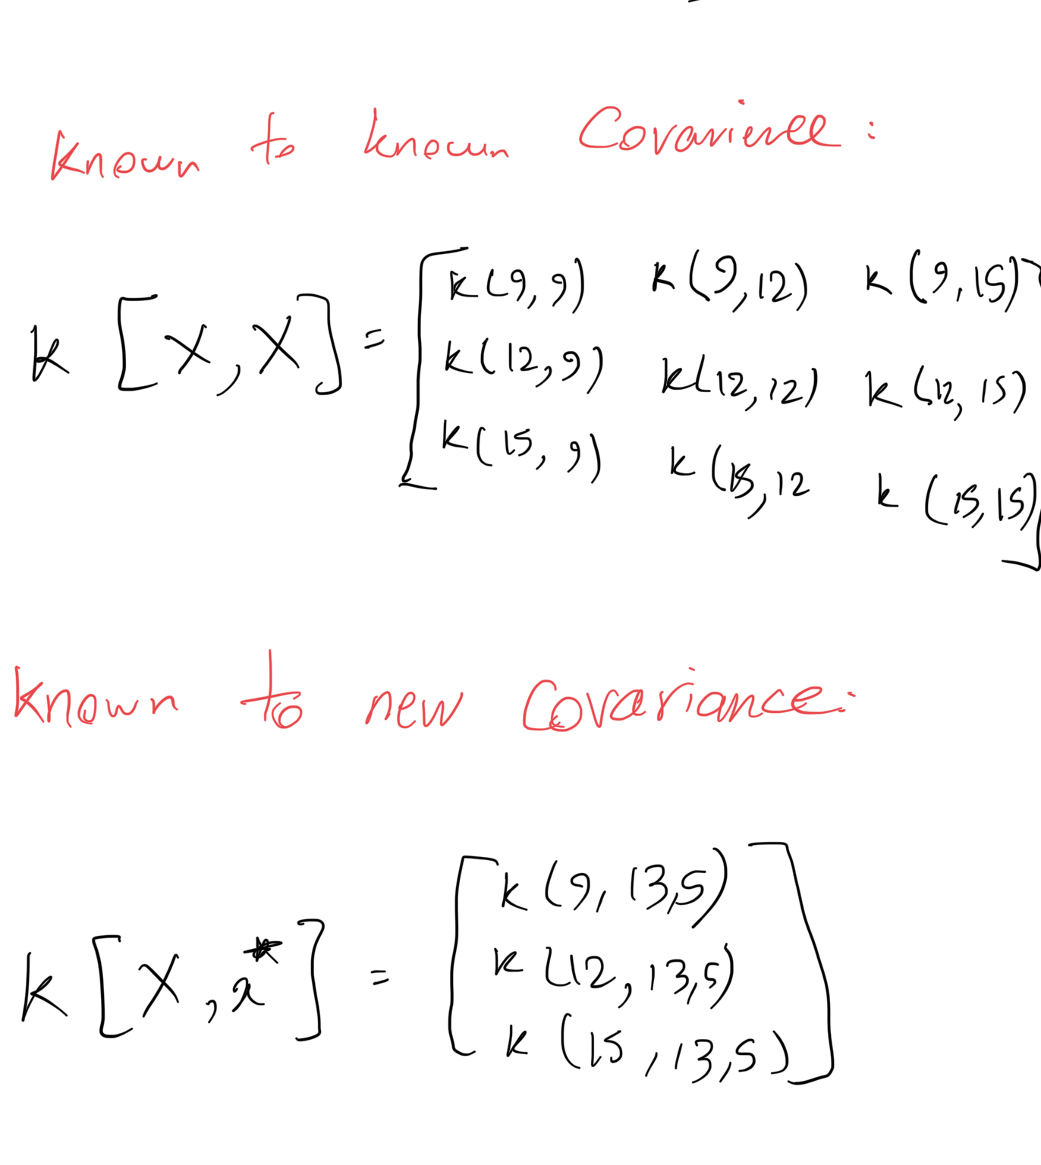
Vector
Vector

Slide 28
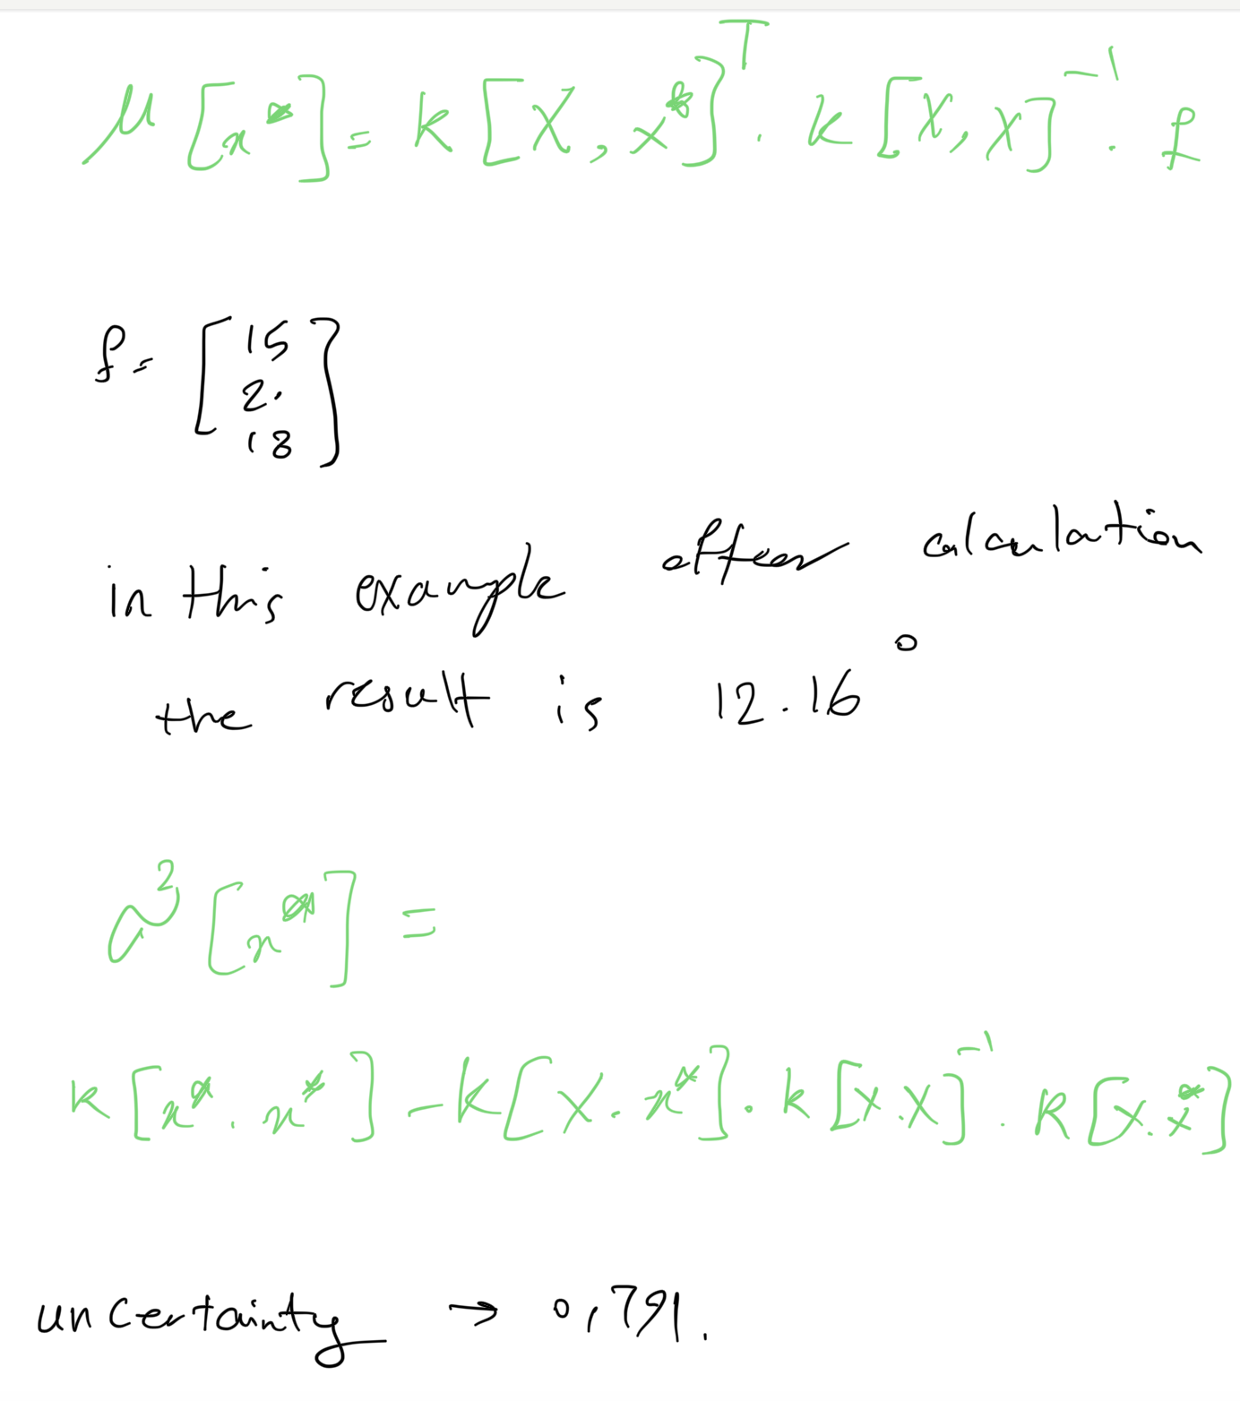
The mean prediction is around 12.15°C, which is lower than expected given the neighboring temperatures at 12 PM (20°C) and 3 PM (18°C). This suggests that the Gaussian Process model might be struggling with interpolation here, potentially due to the large time gaps and the influence of the lower 9 AM temperature (15°C)

Slide 30
Acquisition functions
Now that we have a model of the function and its uncertainty, we will use this to choose which point to sample next. The acquisition function takes the mean and variance at each point x on the function and computes a value that indicates how desirable it is to sample next at this position. A good acquisition function should trade off exploration and exploitation.

Slide 31
popular acquisition functions:
Upper confidence bound
Probability of improvement
Expected improvement
Thompson sampling

Slide 32
Upper confidence bound
High β→ More exploration
Low β→ More exploitation
Notes:
Use a decreasing β\betaβ function, such as βt​=log(t+1), where t is the iteration number. This allows high exploration at the beginning and gradually shifts to exploitation.

Slide 34
Questions
Thank you

