Slide 1
EMNLP 2026
Latent-LoRA
Compact Latent-Space Adapters with Gradient-Free Routing for Continual Learning
Reza Rahimi Azghan · Gautham Krishna Gudur · Giulia Pedrielli · Pavan Turaga · Hassan Ghasemzadeh
Arizona State University · The University of Texas at Austin
Replay-free · task-agnostic · no trainable router
pooled embeddings separate tasks on their own
Notes:
Latent-LoRA: continual learning for LLMs with no task identity at test time, no replay buffer, and no trainable routing module.

Slide 2
THE SETTING
Learning tasks in sequence erodes what came before
LLMs have enormous capacity for a new task and very little for preserving the old one.
Tasks arrive one at a time — earlier data is gone for good
48.4
points of forgetting when one LoRA is fine-tuned straight through the sequence (SeqLoRA, SuperNI Order 1)
Task 1
→
Task 2
→
Task 3
→
…
→
Task T
At test time no task identity is given, and no stored examples may be replayed.
1
2
3
Catastrophic forgetting
No task identity
No exemplars
Gradient updates for a new task overwrite the weights that carried earlier ones. Parameter count makes LLMs especially prone to it.
In the task-agnostic setting the model is never told which task an input belongs to — it has to work that out itself.
Nothing from previous tasks may be stored or replayed, so forgetting cannot be patched up after the fact.
Latent-LoRA · EMNLP 2026
2
Notes:
The setting: sequential tasks, no replay, no task ID at inference. A single sequentially fine-tuned LoRA loses 48 points on SuperNI — that is the number the rest of the talk drives to zero.

Slide 3
BACKGROUND
Low-rank adaptation
Fine-tuning updates lie in a low-dimensional subspace, so there is no need to train the full matrix.
e = ( W + B A ) h
The pretrained weight is frozen. W ∈ ℝ^{m×n} never receives a gradient; the whole update is carried by the added branch.
+
The update is factorised. ΔW = BA with B ∈ ℝ^{m×r}, A ∈ ℝ^{r×n} and r ≪ min(m, n) — only A and B are trained.
W
B
A
frozen · m × n
m × r
r × n
Cost drops sharply. Trainable parameters fall from m × n to r(m + n), which is what makes per-task adapters affordable.
Each new task can be given its own branch while W stays untouched — which is exactly what continual learning needs.
Placement. Following prior CL work, adapters go on the query and value projections of every attention block.
Latent-LoRA · EMNLP 2026
3
Notes:
LoRA reparameterises the weight update as a product of two thin matrices. The pretrained weight is frozen, so a task's knowledge lives entirely in its branch — that separability is what the continual-learning literature builds on.

Slide 4
BACKGROUND
One branch per task: what multi-branch CL buys you
Give every task its own adapter, freeze everything that came before, and forgetting cannot happen through the weights.
1
Isolation by construction
Branches accumulate
When task t arrives it receives a fresh branch. Every earlier branch is frozen, so no gradient step can overwrite knowledge the model already has.
Branch 1
frozen
Branch 2
frozen
2
Reduced subspace overlap
O-LoRA additionally constrains each new branch to the orthogonal complement of the previous ones, limiting how much tasks collide in weight space.
Branch 3
frozen
Branch T
training
3
Cheap per task
A task costs one small adapter, not a copy of the model, so the sequence can grow without the storage becoming untenable.
?
At inference no task identity arrives with the input. Which branch — or which combination — should act on it?
Latent-LoRA · EMNLP 2026
4
Notes:
Multi-branch training solves the training-side problem completely: frozen branches cannot be overwritten. What it does not solve is the inference-side problem, which is where the rest of the paper lives.

Slide 5
BACKGROUND
Two existing answers, and what each one costs
Per-task branches solve the training side. Inference is where both approaches pay.
SUM EVERY BRANCH
LEARN A GATE
O-LoRA
GainLoRA
e = ( W + Σ_{t} B_{t} A_{t} ) h
e = ( W + Σ_{t} g_{t}(x) · B_{t} A_{t} ) h
Branches are trained in mutually orthogonal subspaces, then simply added at test time.
A small MLP gate per task activates its own branch and suppresses the others.
Every branch acts on every input.
The gates need protecting too.
Adapters trained for one task distort predictions on another, and forgetting returns despite frozen parameters. FM 17.2 on SuperNI Order 1.
Gate parameters grow linearly with the number of tasks, and gate training interferes with earlier gates — so Gradient Projection Memory is layered on top.
Our target: keep per-task branches isolated, route without a task ID, and add no component that can itself forget.
Latent-LoRA · EMNLP 2026
5
Notes:
O-LoRA sums everything, so irrelevant adapters pollute every prediction. GainLoRA gates, but the gate is a trainable module that forgets, so it needs its own continual-learning machinery.

Slide 6
COMPONENT 1 · THE ADAPTER
Adapters that live in the pretrained principal subspace
Take the rank-r truncated SVD of each target weight once, and never touch it again.
ΔW_{t} = U_{r} Σ_{r} R_{t} V_{r}⊤
What it is. Following LoRA-XS, we factor W ≈ U Σ V and freeze all three factors, so a task's update is confined to the span of the top r singular directions.
=
One small matrix trained. Only the square adapter receives gradients: r² parameters per module, a count that does not depend on the model dimension.
ΔW
U
Σ
R
V
m × n
frozen
frozen
trained
frozen
Optimal by Eckart–Young–Mirsky. Among rank-r subspaces this one best approximates the update in Frobenius norm.
147K vs 2,359K
Snapshot isolation. Once trained, an adapter is frozen and never rewritten, so no later task can corrupt it.
trainable parameters per task on T5-Large — 16× fewer than LoRA at r = 8, and 80× fewer on Llama-2-13B.
Latent-LoRA · EMNLP 2026
6
Notes:
To our knowledge this is the first use of latent-space adapters in continual learning. The high-dimensional factors come from the pretrained weight and stay frozen; the only degree of freedom is a small square matrix — which is also what makes the interference analysis possible.

Slide 7
COMPONENT 1 · THE ADAPTER
Orthogonality, applied where interference actually lives
Because U and V are frozen and orthonormal, they cancel out of the cross-task interference term.
Output perturbation of task j
δ_{j}(h) = U_{r}Σ_{r}R_{j}V_{r}⊤h
PROPOSITION 1
| δ_{i}(h)⊤δ_{j}(h) | ≤ ‖ R̃_{i}⊤R̃_{j} ‖₂ · ‖ψ(h)‖²
The second factor depends only on the input and the pretrained subspace — training cannot inflate it. Driving the regulariser to zero suppresses interference uniformly over all inputs.
Their inner product decomposes exactly
δ_{i}(h)⊤δ_{j}(h) = ψ(h)⊤ R̃_{i}⊤R̃_{j} ψ(h)
Why standard LoRA cannot do this
So we penalise that kernel directly
O-LoRA penalises ‖A_{i}⊤A_{j}‖, but the up-projections B_{i}⊤B_{j} enter multiplicatively and stay unconstrained — no uniform bound exists.
L_{ortho} = Σ_{i<j} ‖ R̃_{i}⊤R̃_{j} ‖_{F}²
TRAINING OBJECTIVE
where ψ(h) = V_{r}⊤h is the latent projection and R̃_{t} = Σ_{r}R_{t}, the singular-value-weighted adapter — so directions with larger singular values are penalised proportionally.
Language-modelling loss on task t plus λ times the orthogonal penalty against every earlier adapter. Only the current adapter receives gradients.
Latent-LoRA · EMNLP 2026
7
Notes:
The structural payoff: interference between two tasks is a quadratic form whose kernel is exactly what we regularise. No uncontrolled residual — which is precisely what standard LoRA's orthogonality penalty leaves behind.

Slide 8
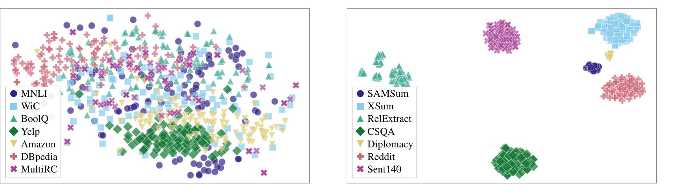
COMPONENT 2 · THE ROUTER
The base model already knows which task it is looking at
Pooled token embeddings from the frozen embedding layer separate task distributions on their own.
1
What the router is for
In the task-agnostic setting something has to decide which adapter acts on an input. That decision is the only remaining channel through which old tasks can degrade.
2
Where the signal comes from
ϕ(x) = MeanPool(Emb(x)) . a fixed-size vector taken straight from the model's own input embedding table, with no task-specific training.
t-SNE of pooled T5-Large embeddings — Long Sequence (left), SuperNI (right). Clusters form with no task-specific training; similar patterns hold across all five model scales.
3
Why it never drifts
Adapters are applied to the attention projections, not the embedding layer, so ϕ is stationary: the distributions the router was fitted on do not move as new tasks arrive.
The consequence:
routing needs a density estimate over an already-separated space, not a learned classifier. That is a job a Gaussian mixture can do without a single gradient step.
Latent-LoRA · EMNLP 2026
8
Notes:
This is the observation the whole method rests on. The separation is not something we train for — it is already present in the pretrained embedding table, and it stays put because we never adapt that layer.

Slide 9
COMPONENT 2 · THE ROUTER
A Gaussian mixture with nothing to train
Means come from K-means, the covariance is a pooled statistic, and the posterior does the blending.
Per-task mixture of K = 5 Gaussians
p( ϕ(x) | t ) = Σ_{k} π_{t,k} N( ϕ(x) | μ_{t,k}, C )
No trainable parameters
No gradient ever flows into the router, so it cannot itself be corrupted by later training — and needs no protection mechanism of its own.
One covariance shared across all tasks (LDA-style pooled scatter)
C = ( Σ_{t} S_{t} ) / ( Σ_{t} n_{t} ) + ε I
Incremental
Task posterior under a uniform prior
A new task means fitting K means on its embeddings and updating the shared covariance. Previous tasks' data is never revisited.
p( t | x ) = p(ϕ(x) | t) / Σ_{t′} p(ϕ(x) | t′)
Soft blending of the stored adapters
R(x) = Σ_{t} p( t | x ) R_{t}
Cheap at both ends
Seconds of CPU per task to fit; at inference, Mahalanobis distances against K×T components and a softmax on a vector we already computed.
Multiple components per task capture multi-modal distributions — a QA task may hold both short factoid questions and long passage-based ones.
Contrast: GainLoRA's gates are trainable, so they forget — and need Gradient Projection Memory to stop them.
Latent-LoRA · EMNLP 2026
9
Notes:
Everything here is closed-form or a counting statistic. Sharing a single covariance follows the LDA principle of pooled within-class scatter, which rescales the space toward task-discriminative directions and keeps the estimate stable when a task has few samples.

Slide 10
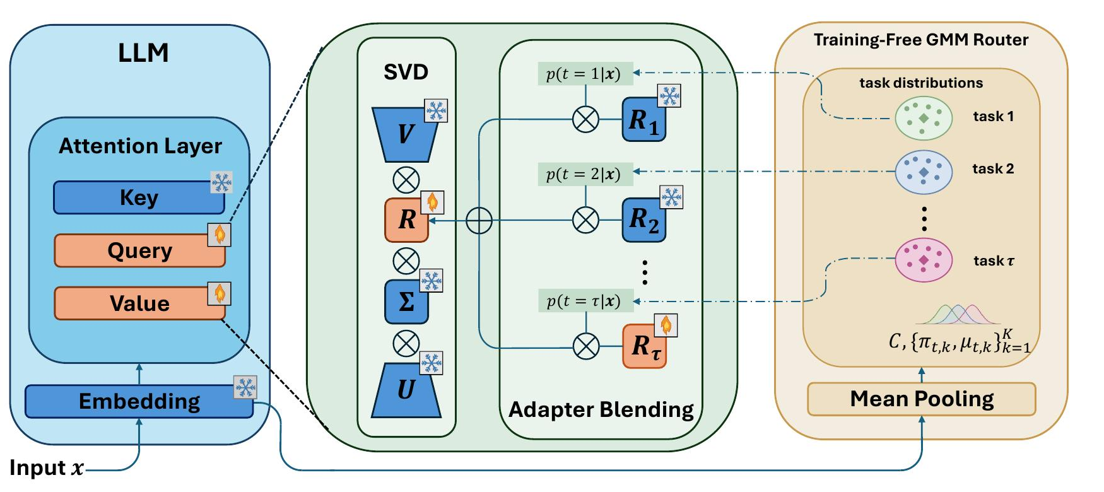
THE SYSTEM
Putting the two components together
Training on task t
At inference
1. Freeze the base model, its embedding layer, and every earlier adapter.
2. Train the task's square adapter with the LM loss plus the orthogonal penalty.
3. Snapshot the adapter; fit its Gaussian mixture and update the shared covariance.
1. Pool the input's frozen embedding — already computed in the forward pass.
2. Score it against every task's mixture to get the posterior p(t | x).
3. Blend the stored adapters into R(x) and insert it into each attention projection.
Latent-LoRA · EMNLP 2026
10
Notes:
Read the figure left to right: the input hits the frozen embedding layer; that same pooled embedding feeds the router on the right; the posterior blends the per-task R matrices; the blended R is inserted into the frozen SVD factorisation of the query and value projections.

Slide 11
EVALUATION
What we measure
Both metrics are read off the same matrix of scores collected during the sequence.
AVERAGE PERFORMANCE (AP ↑)
a_{i,j} = score on task j after training on task i
AP = (1/T) Σ_{j} a_{T,j}
task 1
task 2
task 3
task 4
Mean score across all tasks once the final task has been trained — how good the model is at the end.
after 1
peak
FORGETTING MEASURE (FM ↓)
after 2
peak
FM = (1/(T−1)) Σ_{j<T} ( max_{i≥j} a_{i,j} − a_{T,j} )
after 3
peak
Mean drop from each task's peak score to its final score — how much was lost along the way.
after 4
final
final
final
final
Scoring per task type
Classification tasks are scored by exact-match accuracy; generation tasks by Rouge-L, with greedy decoding and a 50-token cap. Every run is repeated with three seeds and averaged.
AP averages the final row.
FM averages peak minus final, per task.
Latent-LoRA · EMNLP 2026
11
Notes:
The grid makes the two metrics concrete: the last row is what the model can do when everything is over, and the gap between each column's best cell and its last cell is what was forgotten.

Slide 12
EVALUATION
Two established continual-learning benchmarks
Fifteen tasks each, in two orderings apiece — the same task selections and orders used by O-LoRA and GainLoRA.
SuperNI
Long Sequence
Wang et al., 2022 · 15 tasks · 5 categories · mostly generation
Razdaibiedina et al., 2023 · 15 tasks · all classification
Dialogue generation
Sentiment analysis
MultiWOZ · Diplomacy · PersonaChat
Yelp · Amazon · IMDB · SST-2
Information extraction
Topic classification
Outcome extraction · GLUCOSE · Relation extraction
DBpedia · AG News · Yahoo
Question answering
Natural language inference
Quoref · CommonsenseQA · SciQA
MNLI · RTE · CB
Summarization
Paraphrase & word sense
Reddit TIFU · XSum · SAMSum
QQP · WiC
Sentiment analysis
Question answering
SST-2 · Emotion · Sentiment140
COPA · BoolQ · MultiRC
Orders 1–4: two task orderings per benchmark, so results are not an artefact of one lucky sequence. SuperNI is scored with Rouge-L except for its three classification tasks; Long Sequence is scored with accuracy throughout.
Latent-LoRA · EMNLP 2026
12
Notes:
SuperNI is the harder of the two: fifteen tasks spanning generation and classification, which is where indiscriminate adapter aggregation hurts most. Long Sequence is fifteen classification tasks, several of which are close cousins — four sentiment datasets, for instance — which is the stress test for the router.

Slide 13
RESULTS
Best average performance on every configuration
T5-Large, task-agnostic and replay-free, averaged over three seeds.
0.01
forgetting on SuperNI — the metric is essentially zeroed out on both orders
+1.8 to +3.6
AP over GainLoRA across the four configurations
Methods that sum adapters at inference (O-LoRA, InfLoRA) forget most where tasks are most diverse.
Latent-LoRA · EMNLP 2026
13
Notes:
Highest AP and lowest FM on all four configurations. The forgetting measure is the more striking number: 0.01 on SuperNI, because a frozen snapshot plus accurate routing means old-task behaviour barely moves.

Slide 14
RESULTS
The gap widens with scale, and the cost shrinks
Five model scales, encoder-decoder and decoder-only, up to 13B parameters.
Trainable parameters per task
LoRA r=8
Ours r=32
Saving
T5-Large
2,359K
147K
16×
T5-XL
5,898K
147K
40×
Llama-2-7B
4,194K
66K
64×
Llama-3-8B
4,194K
66K
64×
Llama-2-13B
6,554K
82K
80×
The router adds seconds of CPU fitting per task and one Mahalanobis pass at inference — cheaper than per-task MLP gates.
Vertical axis truncated at 40 to make the margin visible. Forgetting stays at 0.01 on every Llama configuration.
Latent-LoRA · EMNLP 2026
14
Notes:
Two things scale in our favour: the accuracy margin over GainLoRA grows with model size, and the parameter saving grows too, because r squared is independent of the model dimension while LoRA's r(m+n) is not.

Slide 15
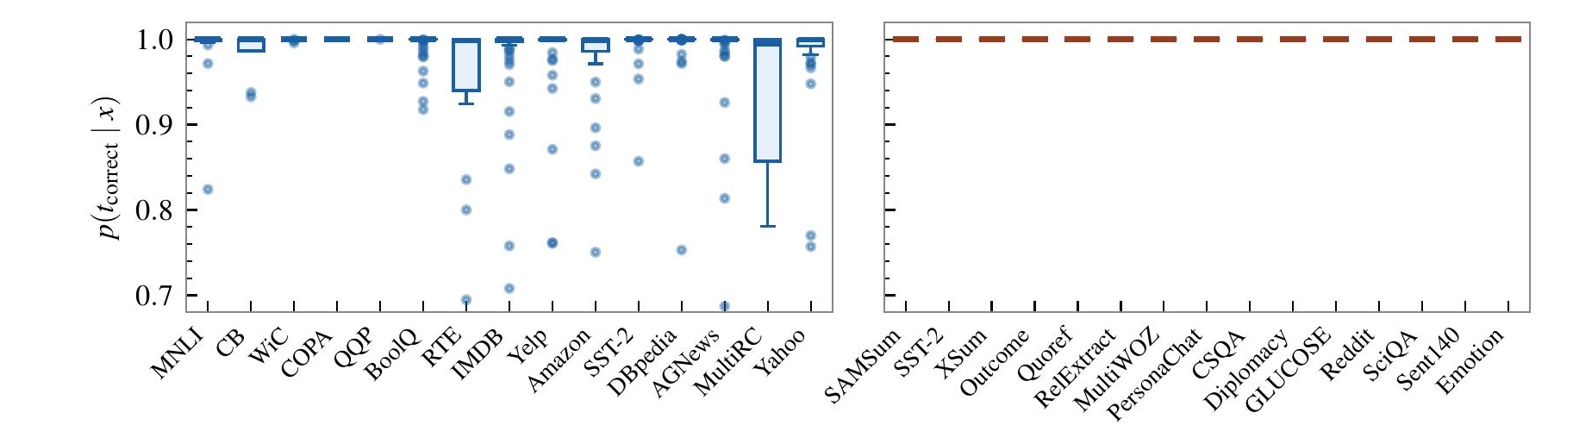
RESULTS
Ablating each component
The adapter is tested with the router switched off; the router is tested on its own posteriors.
Adapter, under sum-at-inference (no router) — AP ↑ / FM ↓
The Σ-weighted penalty carries it
Method
SuperNI 1
SuperNI 2
Long Seq 3
Long Seq 4
Without it the compact parameterisation is worse than O-LoRA everywhere. With it, the same tiny adapter beats O-LoRA on three of four orderings — before the router is switched on at all.
O-LoRA
27.9 / 17.2
33.4 / 11.1
71.3 / 3.4
71.6 / 4.2
Latent-LoRA (λ = 0)
16.7 / 30.1
23.9 / 23.4
57.3 / 19.3
59.2 / 18.7
Latent-LoRA
33.3 / 12.9
35.9 / 8.8
70.1 / 3.0
73.2 / 4.0
Router: posterior probability assigned to the correct task across test inputs (T5-Large) — Long Sequence left, SuperNI right.
Latent-LoRA · EMNLP 2026
15
Notes:
Two independent checks. On the adapter side, the orthogonal penalty is not a marginal addition — the compact parameterisation is not competitive without it. On the router side, SuperNI routes essentially perfectly; Long Sequence is high-confidence with wider spread on the tasks that share input distributions, which is exactly where soft blending earns its keep.

Slide 16
What to take away
Continual learning without a component that can itself be forgotten.
1
Frozen embeddings are already a router.
Limitations
Pooled token embeddings separate tasks across five model scales and both benchmarks, so a Gaussian mixture fitted without gradients is enough for task-agnostic selection.
The shared covariance is inverted each time a task is added — O(d³) in the embedding dimension.
2
The latent subspace makes interference controllable.
Routing accuracy is capped by how separable the frozen embeddings are; near-identical task distributions blur.
With U, Σ and V frozen, cross-task interference is a quadratic form in the r × r adapters — exactly the quantity we regularise, and exactly what Proposition 1 bounds.
Evaluated up to 13B; whether separability and compact-adapter capacity hold beyond that is open.
3
Less machinery, better numbers.
Replay-free, task-ID-free, no trainable routing: state-of-the-art AP on SuperNI and Long Sequence with forgetting at 0.01 and 16–80× fewer parameters per task.
arXiv:2607.23837 · rrahimia@asu.edu
Latent-LoRA · EMNLP 2026
16
Notes:
Close on the framing: prior gating methods add a trainable module and then need a second continual-learning mechanism to protect it. We remove the module instead of protecting it.

Slide 17
PROCESS
How the paper got here: ARR and commitment
EMNLP 2026 reviewed through ACL Rolling Review, but the conference made the final call.
1
2
3
4
5
Submit to ARR
→
Reviews + meta-review
→
Author response
→
Commit to a venue
→
Chairs decide
An anonymous submission goes into a review cycle on OpenReview. Every author must also register for reviewing service.
An Action Editor manages three to four reviewers and writes the meta-review that summarises them.
A rebuttal window in the middle of the cycle. Reviewers may revise their scores before meta-reviews are finalised.
Carry the paper and its reviews to EMNLP 2026 or decline, revise, and resubmit to a later cycle instead.
Program chairs make the acceptance decision: main conference, Findings, or neither. ARR itself never accepts.
What shapes the timeline
The May 2026 cycle — the last one eligible for EMNLP 2026
Cycles run ten weeks, so roughly five per year rather than six.
25 May
ARR submission deadline
2 July
reviews due
Reviews are venue-independent: the same set travels to any participating *ACL venue.
8–14 July
author response window
You cannot commit and resubmit to the next cycle at the same time — it is one or the other.
30 July
meta-reviews released
2 August
commitment deadline for EMNLP 2026
Sources: aclrollingreview.org/dates · 2026.emnlp.org
Latent-LoRA · EMNLP 2026
17
Notes:
Worth stressing for anyone new to ARR: reviews and decisions are decoupled. ARR produces reviews and a meta-review; the conference program chairs decide. That is also why a rebuttal matters so much — it is the last chance to move the reviews that will be carried over at commitment.

Slide 18
REFLECTION
Why it landed where it did
A candid read of the reviews, from the author's side.
What got it in
What kept it out of the main track
1
Simple idea, solid mathematics
1
A couple of ablations missing
The interference decomposition and Proposition 1 gave the design a reason to work rather than numbers that merely came out well.
Reviewers wanted configurations the paper did not report, which left parts of the design unjustified on the page.
2
Broad experimental coverage
2
Unbalanced contributions
Two benchmarks, four task orderings, and five model scales spanning encoder-decoder and decoder-only architectures.
One component accounted for substantially more of the gain than the other, which weakens a two-part story.
3
A strong rebuttal
3
One more axis of evidence
The meta-reviewer described the author response as exemplary. The rebuttal moved the reviews that were carried into commitment.
An additional dataset, or one more ordering of an existing one, would have closed the remaining doubt about generality.
Main-track acceptance sat near 14%. Nothing on the right is a flaw in the idea: each one is a concrete, fixable gap in the evidence, and worth carrying into the next paper.
Latent-LoRA · EMNLP 2026
18
Notes:
Be direct here: the mathematics and the rebuttal were the strengths, and the gaps were all about evidence rather than the core claim. The unbalanced-contribution point is the one worth thinking hardest about — a two-component paper is judged on whether both components earn their place.

