Slide 1
Combining uncertainty-aware predictive modeling and a
bedtime Smart Snack intervention to prevent nocturnal
hypoglycemia in people with type 1 diabetes on multiple
daily injections
AMIA
2024
Impact Factor: 5.9
Citation: 19

Slide 2
Background
Nocturnal hypoglycemia is a major and dangerous challenge for people with Type 1 Diabetes (T1D)
More than 50% of severe hypoglycemic events occur at night, when patients are asleep
Risk is especially high for individuals using Multiple Daily Injections (MDI)
Physical activity during the day significantly increases nocturnal hypoglycemia risk
Existing prediction methods:
Often provide binary alerts only
Do not estimate uncertainty
Do not guide preventive actions
Motivation
Patients need reliable risk prediction, not just alarms
Clinical decision support should:
Quantify risk and uncertainty
Predict timing of hypoglycemia
Enable preventive interventions before sleep

Slide 3
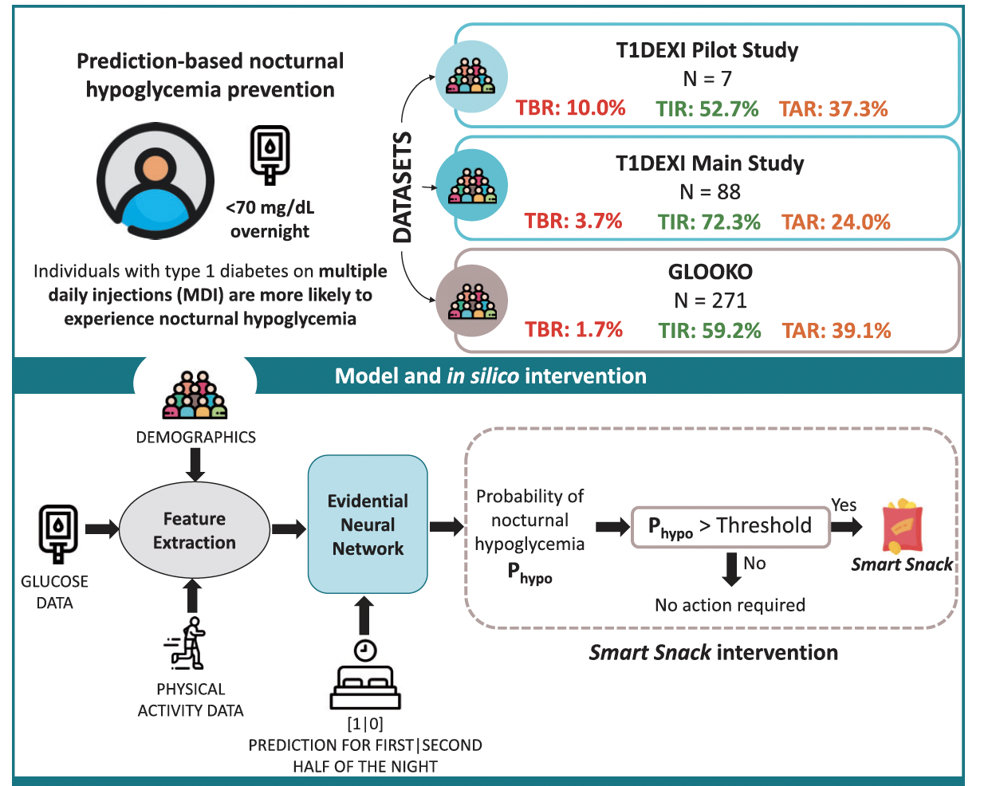

Slide 4
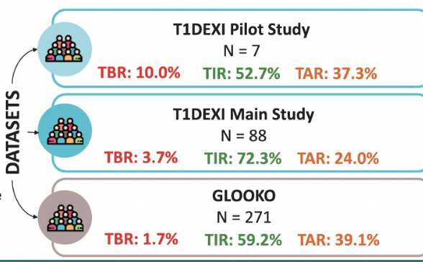
Datasets
366 individuals with Type 1 Diabetes (T1D)
Data sources:
T1DEXI Study (free-living, real-world exercise study)
Glooko (real-world clinical data)
Focus on Multiple Daily Injection (MDI) users only
Inputs include:
Continuous Glucose Monitoring (CGM)
Insulin records
Physical activity (when available)
80/20 split for model training and testing

Slide 5
Feature extraction and selection
The study employed a fully connected evidential neural network that predicts minimum nocturnal glucose along with predictive uncertainty.
What are those 81 inputs made of?
They come from four groups.
1️⃣ CGM-derived features (the majority)
2️⃣ Physical Activity (PA) features (only when available)
3️⃣ Demographics
4️⃣ Prediction-frame indicator

Slide 6





1️⃣ CGM-derived features
CGM signal
Bedtime is known
Cut the CGM relative to bedtime
Stack all those numbers into one vector

Slide 7
2️⃣ Physical Activity (PA) features
Simple descriptors of exercise behavior before bedtime
Used only when activity data are available (e.g., T1DEXI dataset)
What is included
Exercise type (e.g., cardio, strength)
Duration of activity
Intensity level (low / medium)
Timing of exercise during the day
Why PA matters
Physical activity increases overnight hypoglycemia risk
Effects depend on how long, how hard, and when exercise occurred

Slide 8
3️⃣ Demographics
Age
Biological sex
Provide basic population context
Help account for inter-individual differences
4️⃣ Prediction-frame indicator
Single binary input variable
Specifies which part of the night is being predicted:
Early night (0–4 h after bedtime)
Late night (4–8 h after bedtime)

Slide 9
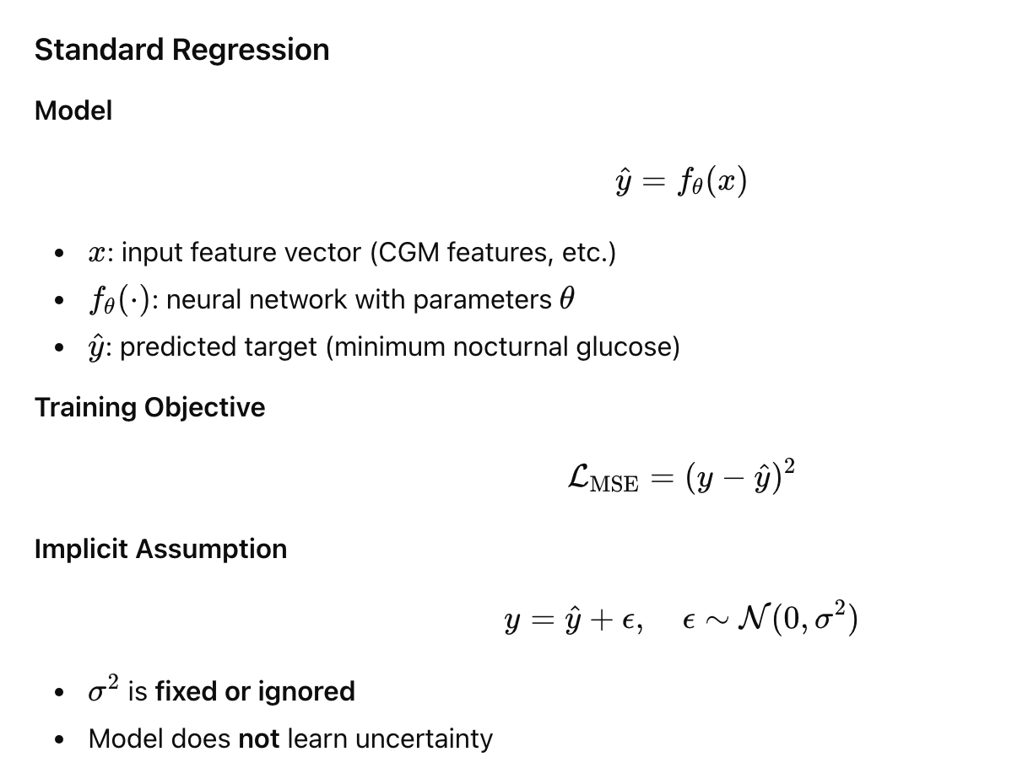
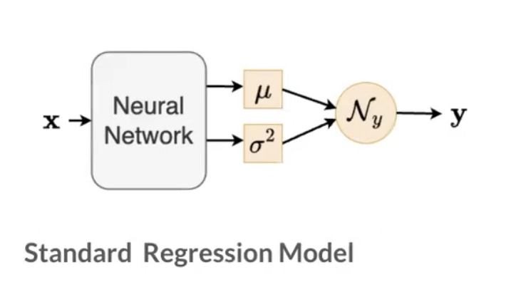

Slide 10
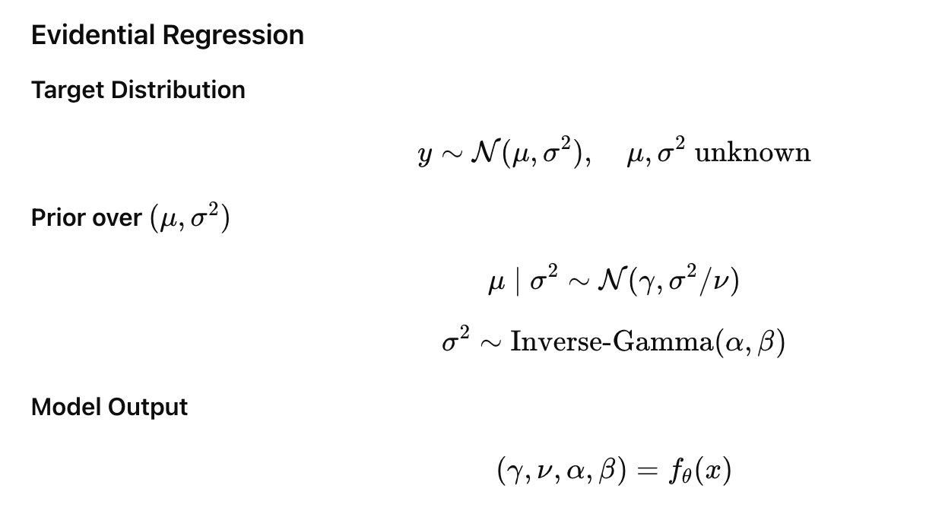
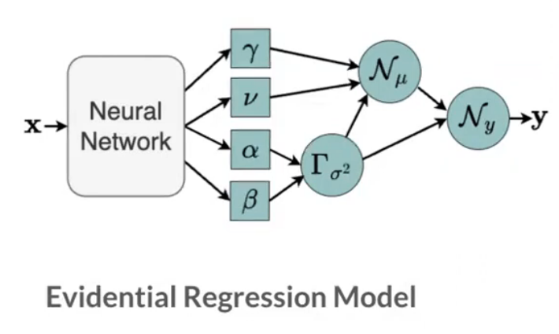

Slide 11
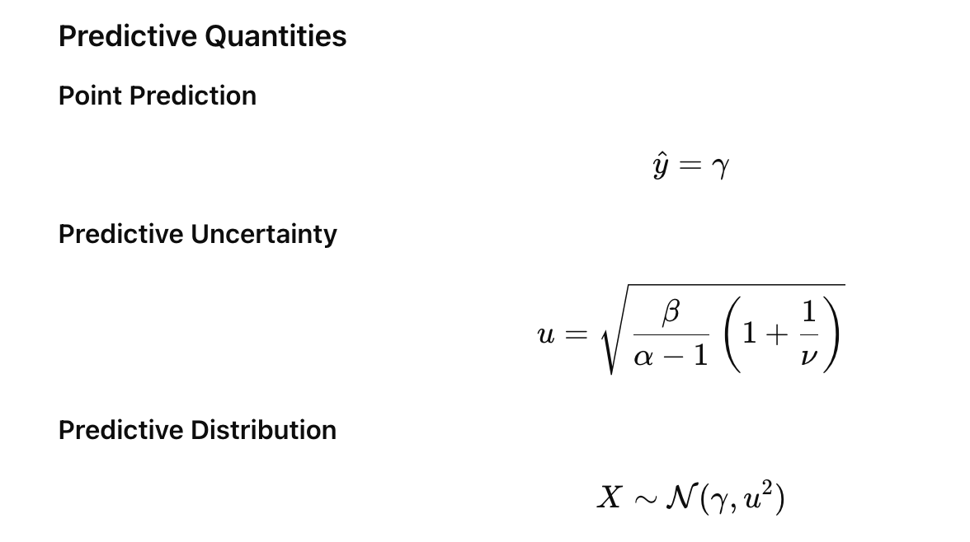

Slide 12
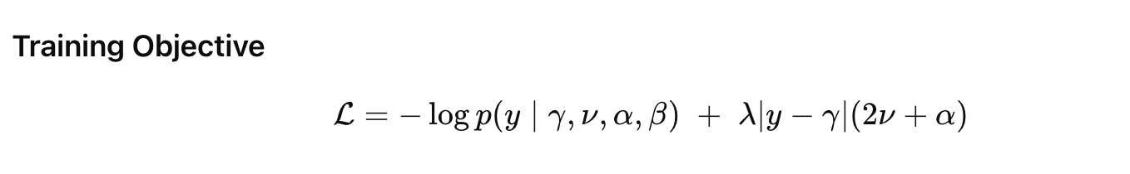


Slide 13
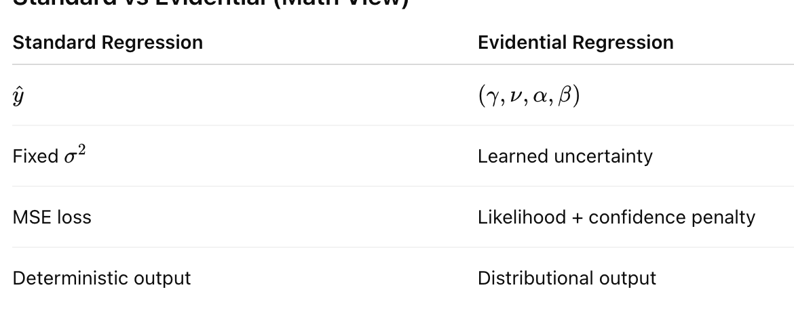

Slide 14

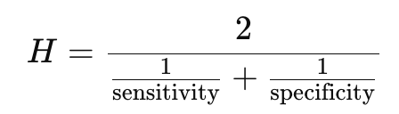
Evaluation of Nocturnal Hypoglycemia Prediction
Evaluation task: binary prediction
Hypoglycemia occurs vs. does not occur
Model trained as regression, evaluated as classification
Risk score:
From predicted glucose distribution, compute
Binary decision:
Risk ≥ threshold → predict hypoglycemia
Risk < threshold → predict no hypoglycemia
Threshold selection:
Chosen on training data
Maximizes harmonic mean of sensitivity and specificity
Metrics (test set):
AUROC, Sensitivity, Specificity, AUPRC

Slide 15
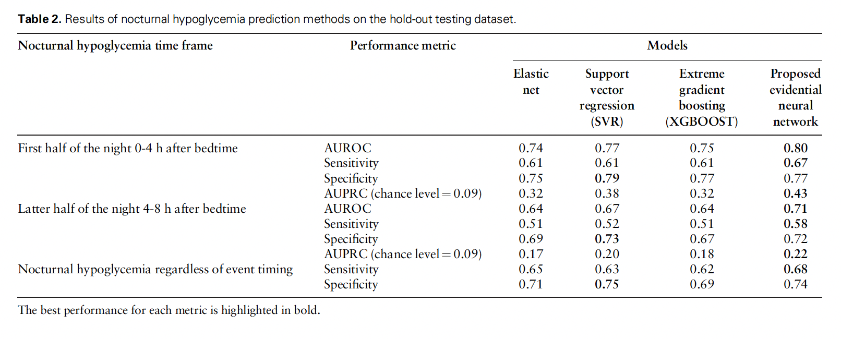
Result
Prediction Performance (Model Accuracy)

Slide 16
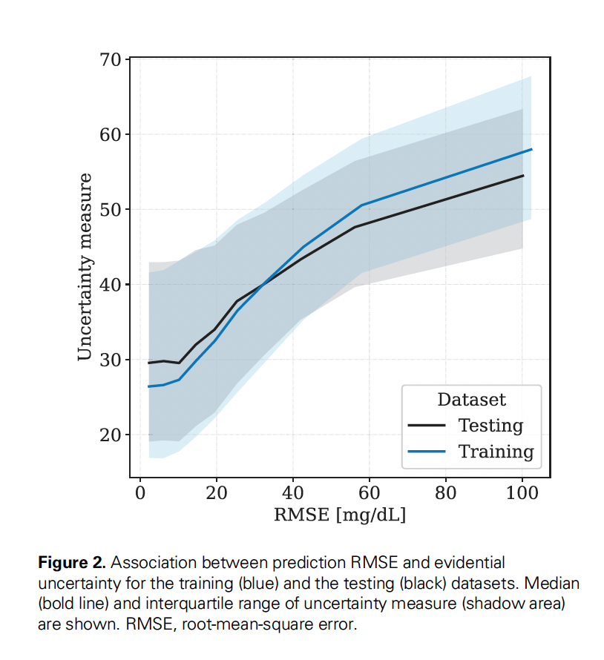
Result
Uncertainty Meaningfully Reflects Error

Slide 17
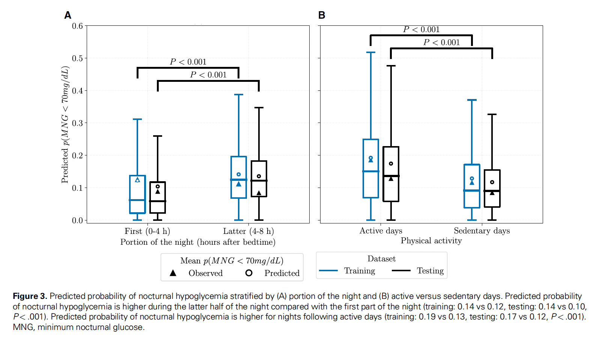
Risk Differences by Night Segment & Activity

Slide 18
Smart Snack Intervention & Evaluation
When: bedtime snack recommended if predicted hypoglycemia risk is high
What: clinician-informed snack (15–30 g carbs)
How:
0–4 h risk: rapid-acting carbs
4–8 h risk: mixed macronutrient snack
Thresholds: learned via hyperparameter tuning
In Silico Evaluation
20 virtual adults with T1D
3-arm crossover (no snack / ENN-based / Oracle)
77 days per arm (4620 total days)
Outcomes from simulated CGM (overnight + 24 h)

Slide 19
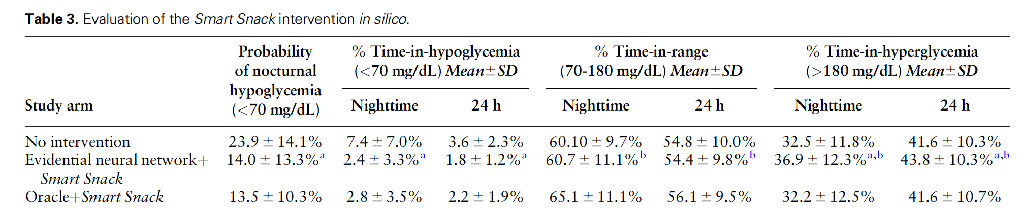
4️⃣Smart Snack Intervention (In Silico Trial)

Slide 20
Questions?
Thank you!

