Slide 1
HealthFlow: A Self-Evolving AI Agent with Meta Planning for Autonomous Healthcare Research
Release date: Oct 11, 2025.
arXiv preprint
not yet peer-reviewed

Slide 2
🧠 Definition
Agentic AI = AI systems that can plan, act, and reflect
They don’t just answer questions — they decide how to reach goals
Agentic AI (from “agent”) denotes an AI system that possesses agency — the capacity to:
Perceive its environment (through data, sensors, or knowledge bases),
Reason and plan toward explicit or implicit goals,
Execute actions via available tools or APIs,
Evaluate outcomes of its own behavior, Adapt or self-correct over time through feedback or reflection.
 | Traditional AI | Agentic AI
 | Open (input → output) | Closed (sense → plan → act → reflect)
 | Static model parameters | Dynamic behavioral adaptation
 | Single-turn reasoning | Multi-step, persistent reasoning
 | Data-driven | Experience-driven (meta-learning)
 | GPT-4 answering a question | HealthFlow, AutoGPT, OpenDevin, Voyager

Slide 3
🧩 The Core Loop
Every Agentic AI follows this simple cycle:
Plan → Act → Observe → Reflect → Improve
You can think of it like how a human researcher or programmer works:
Plan what to do
Do it
See what happens
Learn from it
Try again, better
This is often called a self-reflection loop or feedback loop.

Slide 4
🧠 Background
Explosion of scientific literature, datasets, and knowledge bases -> Huge opportunity for AI-driven discovery, especially in healthcare
Large Language Models (LLMs) enable a new paradigm autonomous agents that automate end-to-end research workflows
⚙️ Problem
Current AI agents are limited by static, predefined strategies
Can refine tool use or reasoning templates, ❌ but cannot learn new strategies or adapt dynamically
This limits autonomy in open-ended, noisy healthcare research
💡 Proposed Solution: HealthFlow
A self-evolving AI agent framework
Performs meta-level strategic planning, learning, and reflection
Treats every task as an experience → refines its own high-level policies
Learns not just to execute, but to manage and strategize

Slide 5
🧪 Benchmark: EHRFlowBench
A new benchmark for AI-driven EHR analysis
Derived from peer-reviewed scientific literature
Evaluates complex, real-world healthcare research workflows
🚀 Key Contributions
HealthFlow: Meta-level learning and self-evolution
EHRFlowBench: Realistic benchmark for agentic healthcare tasks
Empirical Results: Significant gains in task success, robustness, and efficiency

Slide 6
Related Works
🧰 Predefined Agentic Workflows
Early agentic systems follow human-designed, fixed loops.
Examples:
AutoGPT, GPT-4Tools → Chain LLM calls but strategy is hard-coded.
HuggingGPT, MetaGPT → Add multi-agent roles, yet still static.
SciToolAgent, Robin, Biomni → Automate science tasks but keep a fixed “select-plan-execute” cycle.
⚠️ Limitation: Cannot adapt or change their high-level strategy — they follow a script.
🧬 Towards Self-Evolving Agents
Newer research lets agents improve themselves, but only at the operational level.
STELLA, OriGene → Expand tool libraries & refine reasoning templates.
Self-Refine, Reflexion, AlphaEvolve → Iterative self-improvement on single outputs (e.g., code).
TextGrad → Uses LLM-generated feedback for optimization.
⚠️ Still limited: Agents learn to be better tool-users, not strategic managers. Their overall meta-strategy remains fixed and outside their learning scope.

Slide 7
🧩 Core Idea
Every research problem is formalized as a task (T).
The objective of HealthFlow is to produce a solution (S) that fulfills the requirements of T.
Mathematically: T→S
The agent must learn how to transform a task into a valid solution.
🔄 How HealthFlow Operates
The system doesn’t solve tasks in one shot.
It works through a stateful, iterative process, meaning:
Iterative: It performs multiple cycles of thinking and acting.
Stateful: It remembers what happened in previous cycles.
Each iteration = one round of planning, execution, and learning.
🧠 Plan Generation
At each turn i, HealthFlow creates a plan (Pᵢ): Pi={a1,a2,…,ak}
Each action (a) can be:
A tool call (e.g., database query, visualization tool), or
Code execution (running Python scripts or models).
The plan describes how the system will approach the current task.

Slide 8
🧾 Capturing the Process
When plan Pᵢ runs, it produces an execution trace (τᵢ).
The trace records:
All actions taken
Intermediate outputs Errors or failures
Acts as a logbook — used later for analysis and reflection.
💾 Knowledge Accumulation
HealthFlow maintains a growing experience memory (M): M={E1,E2,…,EN}
Each E = a piece of learned knowledge (a heuristic, pattern, or lesson).
The memory expands dynamically after each successful task.
It becomes the agent’s strategic knowledge base for future planning.
🚀 Adaptive Intelligence
After successful completion of a task, the system:
Analyzes the execution trace (τᵢ)
Extracts useful lessons
Updates the memory (M) with new experiences
This enables continuous self-evolution — each success makes future planning more efficient and intelligent.

Slide 9
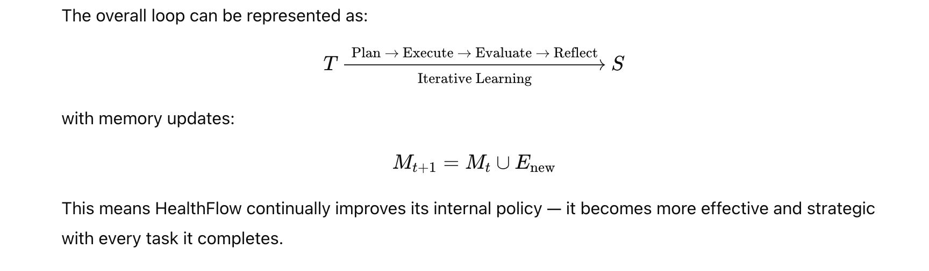

Slide 10


HealthFlow uses four specialized agents to manage complex research tasks.
Each agent focuses on one stage of the problem-solving lifecycle:
AM (Meta agent): plans strategy
AE (Executor): runs tools/code, logs a trace τᵢ
AV (Evaluator): scores sᵢ, returns feedback fᵢ
AR (Reflector): distills new experience E_new into memory M
Meta Agent (Strategic Planner) 🧭 Role: Cognitive Orchestrator
Creates a plan for each task (T). It decides what to do next — the sequence of steps or actions (not the code itself).
Uses experience memory (M). It looks up similar past experiences {Eₖ} from memory using a retrieval function: That means it finds previous cases that might help with the new problem.
Incorporates feedback. If there was a previous failed attempt (fᵢ₋₁), it uses that feedback to make a better plan.
Generates a new high-level plan: Here, AMA_MAM​ is the Meta Agent’s decision function — it combines the current task, relevant past experiences, and feedback to create the new plan.
Sends the plan to other agents. Its output is a structured plan that tells the Executor Agent how to act, the Evaluator what to check, and the Reflector what to learn.

Slide 11


Executor Agent (Execution Engine)
⚙️ Role: Action Performer
Executes the Meta Agent’s plan in a sandboxed environment.
Translates each step into tool calls or code executions.
Produces a complete execution trace (τᵢ):
Ensures transparency — every action and intermediate result is logged.
Integrates with:
Model Context Protocol (MCP)
ToolUniverse (ML models, datasets, and scientific tools)
Evaluator Agent (Short-Term Corrector)
🧩 Role: Quality Controller
Reviews the execution trace (τᵢ) and results.
Compares output to task requirements.
Produces a score (sᵢ) and feedback (fᵢ):
If score < success threshold (θₛᵤcc): → feedback is sent to Meta Agent → new plan (Pᵢ₊₁).
Enables immediate self-correction within a single task.

Slide 12
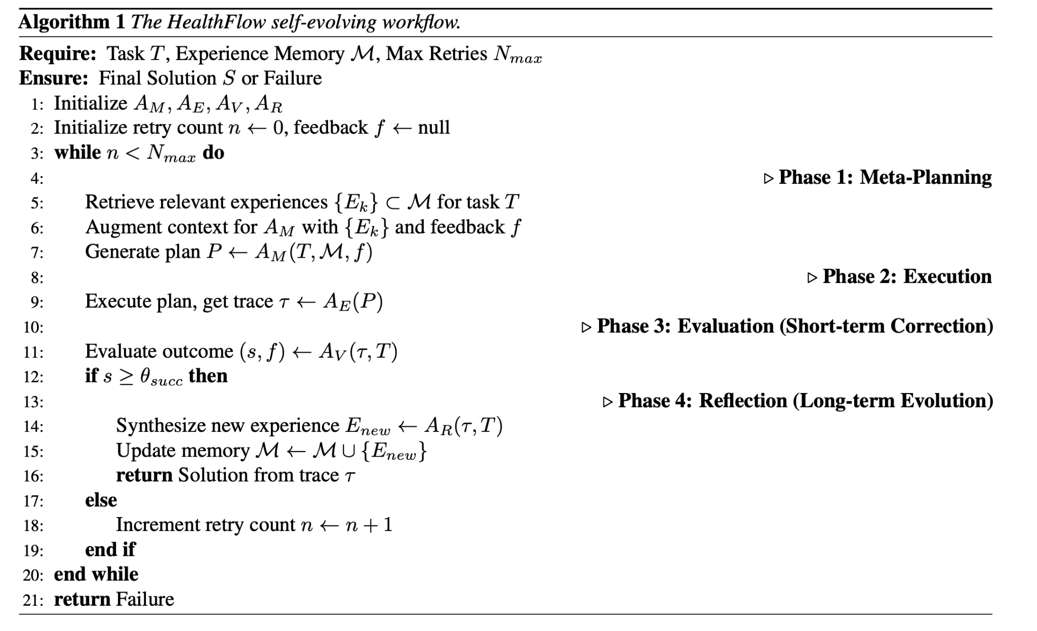

Reflector Agent (Long-Term Learner)
🪞 Role: Knowledge Synthesizer
Activated after successful completion of a task (sᵢ ≥ θₛᵤcc).
Analyzes the entire process history {τ₁, …, τᵢ}.
Synthesizes abstract, reusable knowledge:
Adds new lessons to the experience memory (M).
Learns heuristics, workflow patterns, and warnings for future tasks.

Slide 13

Meta-Level Evolution through Experience
1️⃣ Synthesizing Experience
After a successful task, the Reflector Agent (AR) studies the full execution trace (everything that happened).
It extracts useful lessons and saves them as structured “experiences.”
Each experience E has:
Type (E_type): heuristic, code_snippet, workflow_pattern, or warning
Category (E_category): e.g., EHR_preprocessing, pediatrics
Content (E_content): the actual insight or rule
The new experiences are added to memory:
2️⃣ Using Experience for New Tasks
When a new task T′ comes, the Meta Agent (AM) searches the memory M.
It uses an LLM-based re-ranking to find the top 5 most relevant past experiences.
These are added as context when creating the new plan.
So, with every new task, AM gets smarter — it plans using all the knowledge accumulated so far.

Slide 14
3️⃣ Handling Conflicting Knowledge
Sometimes memory MMM may contain contradictory advice.
HealthFlow doesn’t delete anything — it sees contradictions as context-dependent options.
The Meta Agent chooses which rule fits best for the specific task.
This allows flexible and context-aware reasoning — different strategies for different situations.
4️⃣ Bootstrapping (Training Mode)
At the beginning (when memory is empty), HealthFlow runs in training mode.
It practices on tasks with known correct answers. The Evaluator checks results against the ground truth.
The Reflector saves only verified experiences into the memory.
This builds a solid base of trusted knowledge before facing real, unknown problems.

Slide 15
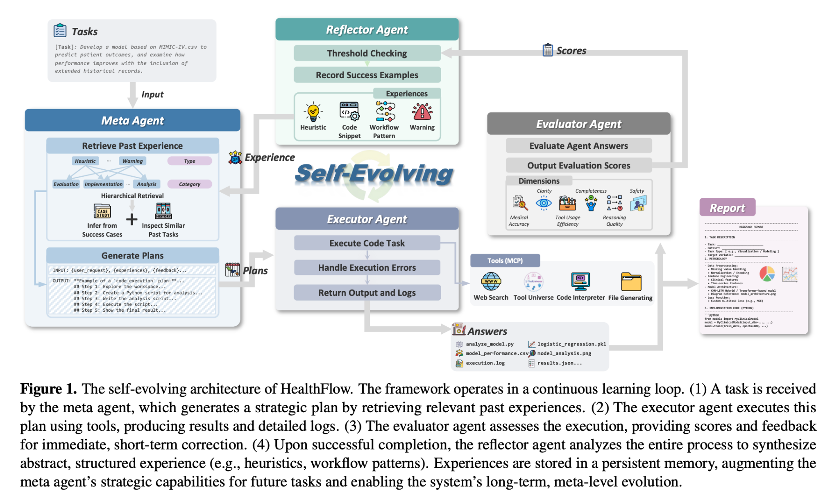

Slide 16
Why EHRFlowBench Was Created
Autonomous agents are getting complex, but we need standard tests to measure if they can really solve research-level problems.
General benchmarks (e.g., GAIA) exist for tool use + reasoning.
⚠ None existed for healthcare research, which is more open-ended and data-driven.
EHRFlowBench fills this gap: a benchmark that mirrors real-world clinical research workflows.
Stage 1: Candidate Paper Screening
Collect papers (2020-2025) – 51 280 from AAAI, ICLR, ICML, NeurIPS, IJCAI, KDD.
Filter for EHR focus – LLM ensemble classifies titles by relevance to AI on EHR data. – 162 candidates → manual review → 118 high-quality papers.
Stage 2: Task Extraction and Curation
Use an LLM to extract tasks from each paper:
detailed description
category
reference answer.
Initial pool → 585 tasks.
Manually merge similar tasks → 10 major categories covering the full research lifecycle (e.g., data prep, model training, evaluation). Apply stratified sampling to keep category diversity.

Slide 17
Final structure of the EHRFlowBench benchmark
Split | Purpose | Count
Training set | bootstrap HealthFlow (1 task per category) | 10
Evaluation set | rigorous testing of agentic performance | 100
Total |  | 110 tasks
Final Benchmark Composition
Each task is:
Evidence-grounded (from peer-reviewed literature)
Complex and multi-step
Designed for reproducible comparison of AI agents in healthcare research.

Slide 18
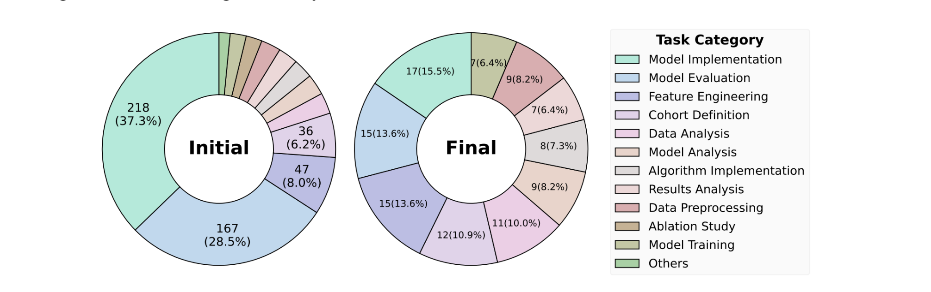
Task category distribution in EHRFlowBench
This figure shows how the 585 initial tasks were refined into the final 110 tasks. Each bar represents a research stage, confirming that EHRFlowBench evenly covers the complete healthcare data-science pipeline

Slide 19
Benchmarks Used for Evaluation
Benchmark | Purpose | Evaluation Metric
EHRFlowBench | Tests end-to-end research workflows | LLM-as-a-judge scoring (1–5) → weighted by method (70%), presentation (20%), artifacts (10%)
MedAgentBoard | Evaluates structured EHR analysis on MIMIC-IV & TJH datasets | Human-reviewed success rate + 4 LLM-judged dimensions: (1) data extraction (2) modeling (3) visualization (4) report
MedAgentsBench | Measures medical reasoning & knowledge retrieval | Accuracy on 100 hard multiple-choice questions
HLE (Humanity’s Last Exam) | Expert-level reasoning in biology/medicine | Binary correctness (right/wrong)
CureBench | Clinical decision-making with external tools (PubMed, FDA DBs) | Accuracy on 100 validation questions (10 used for training)

Slide 20
Baseline Methods
HealthFlow is compared with five categories of models:
General LLMs: DeepSeek-V3, DeepSeek-R1
Medical LLMs: HuatuoGPT-o1, MedGemma
Multi-agent systems: MedAgents, MDAgents, ColaCare
General agent frameworks: AFlow, Alita
Biomedical agents: Biomni, STELLA
Each baseline represents a different level of capability — from simple LLMs to domain-specific multi-agent systems.

Slide 21
Main Results and Ablation Study
✅ Overall Comparison
HealthFlow outperforms all baselines on every benchmark.
Biggest gains appear on:
EHRFlowBench → end-to-end autonomous research.
MedAgentBoard → data analysis and modeling.
Integration with ToolUniverse (large set of ML/scientific tools) gives extra performance lift.
On reasoning-heavy tasks (MedAgentsBench, HLE, CureBench), HealthFlow stays competitive.
🔍 Why others lag
Non-agentic LLMs and limited multi-agent systems can’t run code or multi-step workflows.
Biomedical agents (Biomni, STELLA) do better than generic ones but still lack self-evolving strategy.

Slide 22
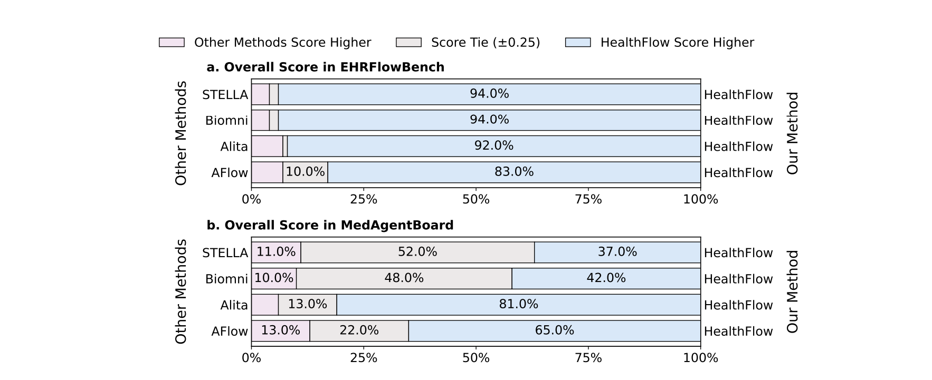
Panel | Benchmark | Meaning
a | EHRFlowBench | open-ended, multi-step healthcare research tasks
b | MedAgentBoard | structured EHR analysis and modeling

Slide 24
1️⃣ Impact of LLM Backbones and Executors
HealthFlow separates its reasoning model (for planning & reflection) and execution model (for coding).
Using a stronger reasoning LLM (DeepSeek-R1) → better plans → higher performance.
But a good planner needs a reliable executor:
When replaced with Qwen3-Coder, performance collapsed (66% → 6%) because it failed basic file-handling instructions.
✅ Best setup: DeepSeek-V3 + ToolUniverse → combines strong reasoning + dependable code execution.
2️⃣ Fine-Grained Evaluation
On EHRFlowBench, HealthFlow scores highest in:
Method soundness (3.72) and Artifact quality (3.96) → produces valid, high-quality code/models.
On MedAgentBoard, strongest in:
Predictive modeling (4.21) and Report generation (4.10).
Competing agents like STELLA are decent at simple sub-tasks (data extraction, visualization), but HealthFlow excels in complete end-to-end modeling.
3️⃣ Dynamics of Experience Learning
HealthFlow adapts dynamically:
In EHRFlowBench (open-ended tasks): creates more heuristics (31%), but retrieves more code snippets (1.9/task) → learns high-level strategies but grounds them in code.
In MedAgentBoard (structured tasks): retrieves more heuristics → focuses on refining existing workflows.
Most learned knowledge falls under Clinical & Medical Analysis, meaning its experience growth centers on core healthcare tasks.

Slide 25
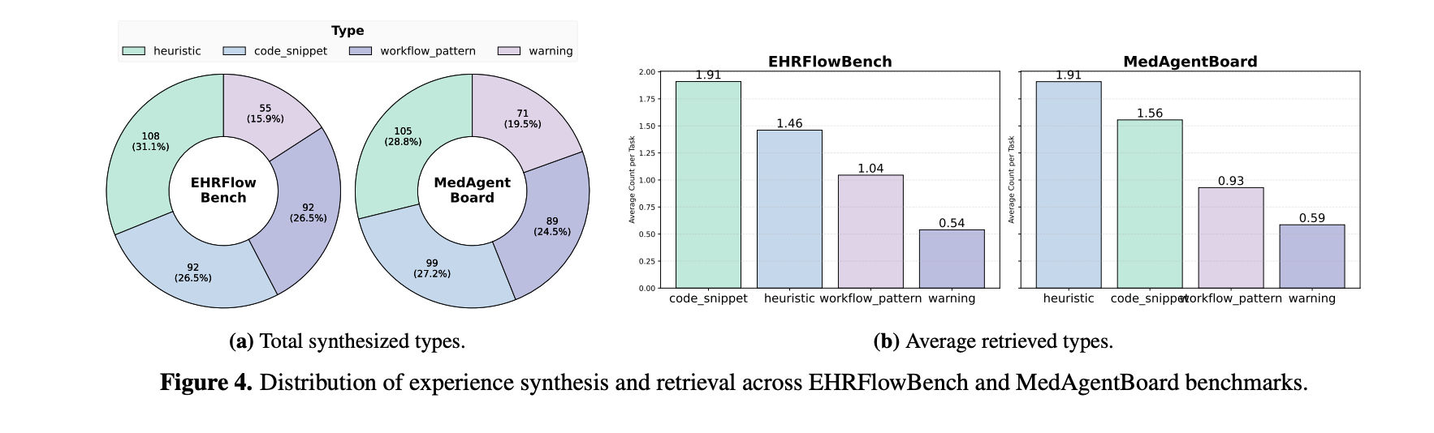

Slide 26
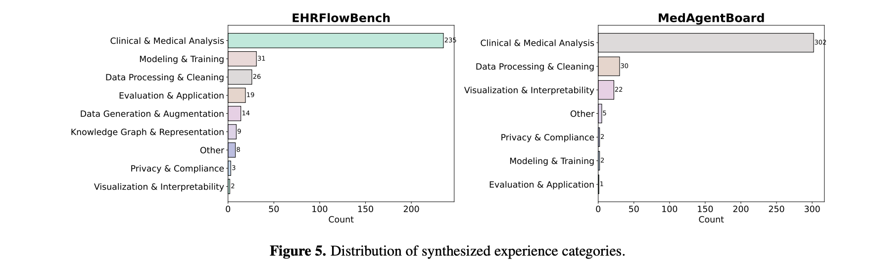

Slide 27
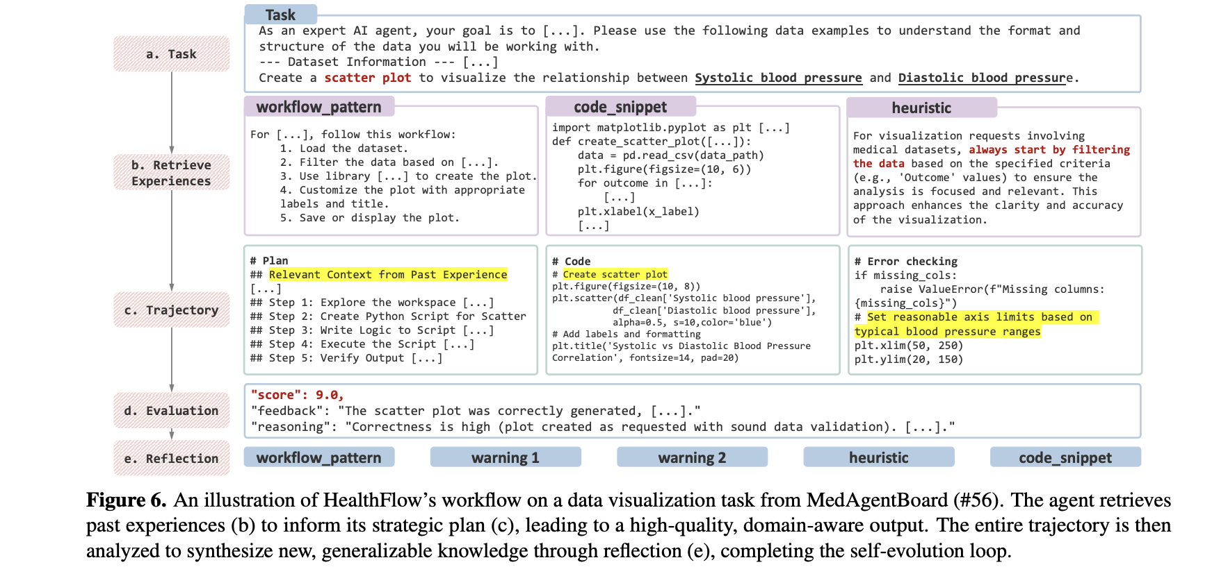
Case Study 1 – Meta-Level Learning in a Data Visualization Task

Slide 28
Case Study 2 – HealthFlow’s Domain Adaptability and Robust Research Execution
✅ First Case: Data Visualization Task (Blood Pressure Plot)
HealthFlow produces a clear, interpretable plot aligned with the reference answer. Competing agents (Biomni, STELLA) fail because they skip validation and include outliers, making results unreadable. Demonstrates the importance of adaptive, domain-aware planning.
Second case (EHRFlowBench):
No dataset provided → HealthFlow simulates realistic data autonomously.
Implements and trains a CNN–LSTM model, generating:
Training loss curve
Accuracy metrics
Saved model checkpoints.
Completes an entire end-to-end research workflow without manual input.
Highlights HealthFlow’s ability to: ✅ Apply learned strategies to new tasks. ✅ Handle open-ended, multi-step scientific problems. ✅ Adapt to domain-specific contexts intelligently.

Slide 29
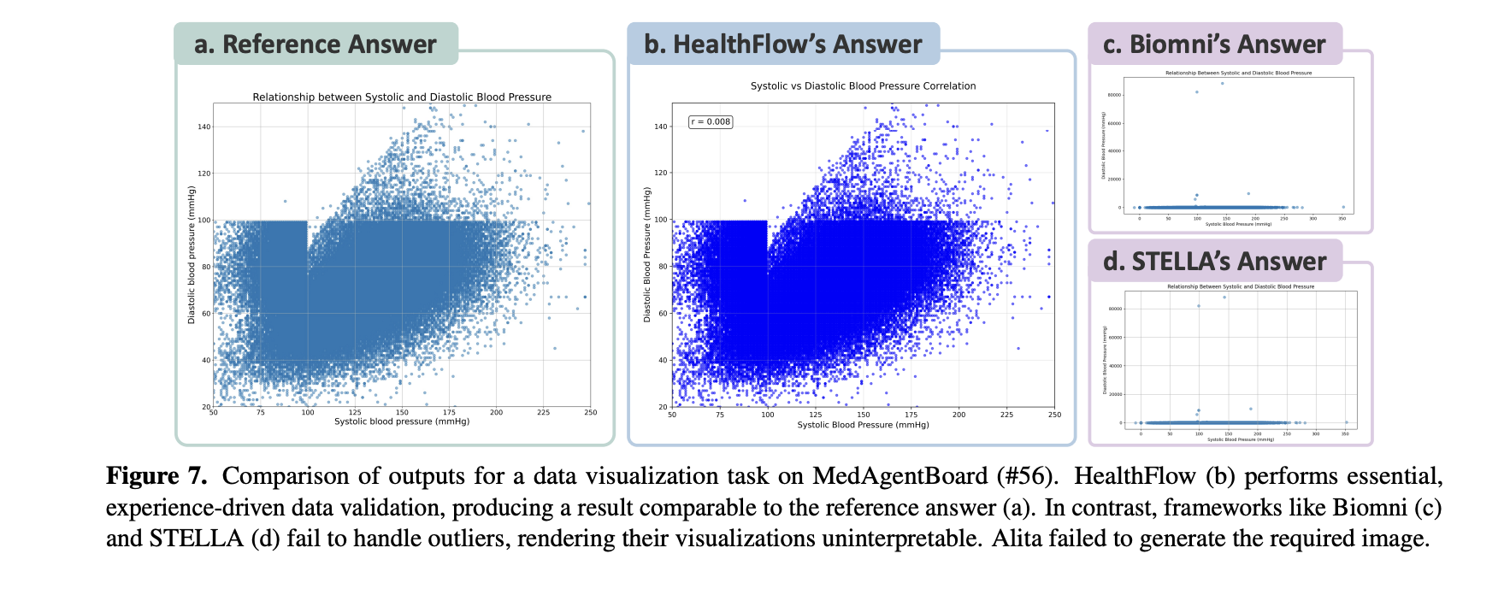

Slide 30
Human Evaluation – Expert Validation of HealthFlow’s Performance
Goal: Assess real-world quality beyond automated scores.
Participants: 12 expert evaluators (PhD & MD students) specializing in:
AI for Healthcare
Biostatistics
Biomedical Engineering
Clinical Medicine
Evaluation Setup:
20 tasks total → 10 from EHRFlowBench, 10 from MedAgentBoard.
Blind Review: Agents’ names and order randomized to prevent bias.
Compared HealthFlow, Alita, Biomni, STELLA head-to-head.
Evaluators selected the single best solution (or “None” if unsatisfactory).
Outcome:
Inter-rater agreement: 71.54% → strong consistency among experts.
Result (Figure 8): Clear expert preference for HealthFlow’s solutions across both benchmarks

Slide 31
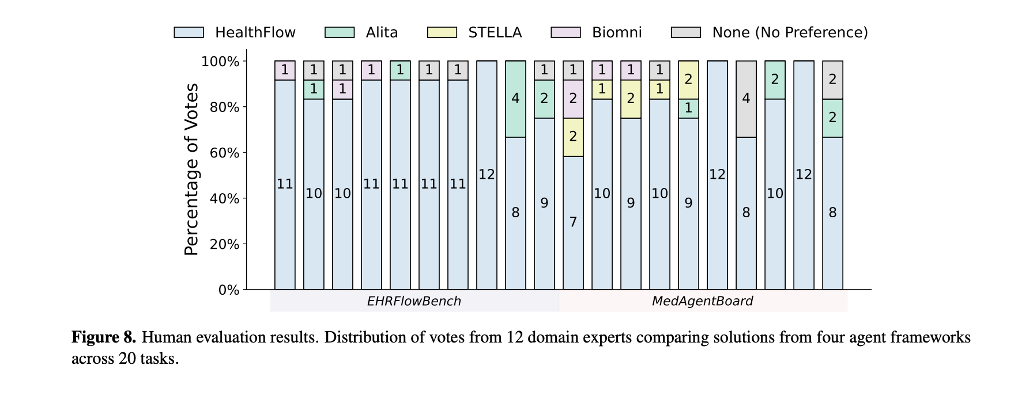
Expert Evaluation – HealthFlow Preferred by Human Reviewers

