Slide 1
CXR-LLAVA: a multimodal large language model for interpreting chest X-ray images
Published year: 2023
Cited by 16

Slide 2
Motivation for This Study
Radiologists’ workload has increased, which can affect diagnostic accuracy.
The study aims to build CXR-LLAVA, a multimodal LLM specifically for interpreting Chest X-Rays and generating radiology reports.
It also explores whether this model can assist with autonomous reporting to reduce radiologists' burden.

Slide 3
Datasets
Dataset 1:
Dataset 1 comprises chest radiograph datasets with pathologic findings labelled. It includes publicly available datasets such as CheXpert, NIH, and VinDR etc. These datasets provide multi-class or binary labeling for radiographic abnormalities.
Dataset 2 :
refers to the MIMIC dataset, which provides free-text radiology reports for chest X-rays. This dataset contains radiologic reports in a free-text form, enabling the model to learn from the textual information associated with the CXR images.
When it comes to ensuring local consistency, comparing embeddings of overlapping patches is necessary. This process involves examining the embeddings of overlapping image patches within the grid-like structure of the image. It ensures that local features extracted from overlapping patches are consistent and aligned.

Slide 4
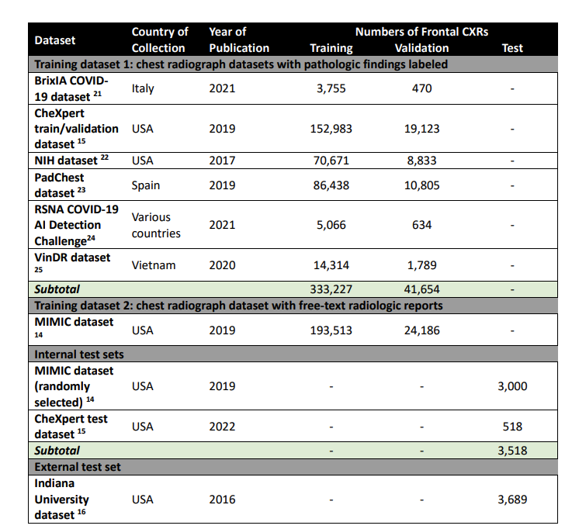
For model training, they included several public CXR datasets, collecting a total of 592,580 frontal CXRs

Slide 5
What is a Multimodal LLM?
A multimodal LLM combines two types of inputs:
Images (processed using an image encoder like ViT - Vision Transformer).
Text (processed using a large language model like LLAMA-2).
These models can interpret visual content (like chest X-rays) and generate textual outputs (like radiology reports or answers).
While general multimodal models (e.g., GPT-4 Vision) can process images and text, they are not optimized for medical images like CXRs. The study adapts an LLM to better understand the specific features and challenges of CXRs

Slide 6
The Large Language and Vision Assistant (LLAVA) is an open-source multimodal model that combines vision encoding with a Large Language Model

Slide 7
Method
Built a new image encoder (ViT-L/16) → Converts CXR images to image tokens.
Connected the image encoder to a Large Language Model (LLAMA-2) → Combines image and text tokens.
Fine-tuned the model using pairs of CXR images and radiology reports → So the model can: Understand the images.
Generate meaningful text reports.

Slide 8
Stage 1: constructing and training a CXR-specific image encoder

Slide 9
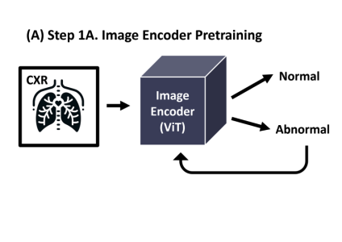
Step 1 (Basic Training):
They built an image encoder that specifically learns CXR abnormalities
A new image encoder was built using ViT-L/16.It was trained on a simple classification task
Input: CXR image.
Output: Binary label (normal/abnormal).
Dataset: 374,881 CXRs.
Result: The encoder learned to capture important features of radiology images that general encoders miss.

Slide 10
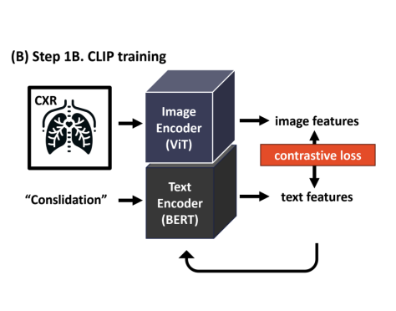
Step 2 (Advanced Training with CLIP):
The goal is to train the image encoder to understand CXRs with their textual descriptions using the CLIP strategy.
Input:
Image: Chest X-ray (CXR).
Text: Medical keyword (e.g., "pneumonia" or "consolidation").
Processing:
Image Encoder (ViT) → Converts the image into image features.
Text Encoder (BERT) → Converts the text into text features.
Contrastive Learning:
If the image and text match → Their features are pulled closer together.
If they don’t match → Their features are pushed further apart.
Training Data:
592,580 image-text pairs from medical datasets.
Notes:
The goal here is to train the image encoder to understand medical images (CXRs) in relation to their textual descriptions using the CLIP strategy.

Slide 11
CLIP
CLIP stands for Contrastive Language-Image Pre-training. It is a strategy used to foster shared representations between images and text. The CLIP method enables the image encoder to learn shared representations between images and text by mapping corresponding image and text pairs closer, and non-corresponding pairs farther apart.
Example:
Matching: Image of pneumonia ↔ "pneumonia" → Vectors move closer.
Non-Matching: Image of pneumonia ↔ "atelectasis" → Vectors move apart.
This is done using a contrastive loss function that rewards the model for bringing correct pairs close and penalizes incorrect matches.

Slide 12
Minimizing Contrastive loss
The contrastive loss function aims to minimize the distance between matching pairs of data (e.g., an image and its corresponding radiologic report) while maximizing the distance between non-matching pairs. By doing so, the model learns to map similar data points close to each other and dissimilar data points farther apart in the feature space.

Slide 13
BERT
In the context of the CXR-LLAVA model, a text encoder based on BERT was utilized to process and understand the radiologic reports associated with chest X-ray (CXR) images, enabling the model to learn the relationship between textual descriptions and visual data.
BERT stands for Bidirectional Encoder Representations from Transformers. It is a type of natural language processing (NLP) model developed by Google. BERT is designed to understand the context and meaning of words in a sentence by considering the surrounding words and their relationships bidirectionally, both to the left and right of the target word.

Slide 14
Stage 2: feature alignment and end-to-end fine-tuning of CXR-LLAVA
The goal is to align the image encoder with the Large Language Model (LLAMA-2) so they can work together to generate radiology reports

Slide 15
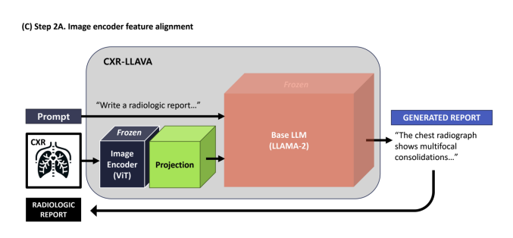
The image encoder (ViT) and the language model (LLAMA-2) are frozen.
Since the image encoder and the LLM use different types of outputs, they introduce a projection matrix (P).
The projection matrix (P):
Acts as a bridge between the image encoder and the LLM.
Adjusts the image features so they align with what the LLM expects.
Allows the LLM to use image information to generate accurate radiology reports.
Notes:
Frozen means their weights (parameters) are not updated during this step.

Slide 16
Training the Projection Matrix
The image encoder processes the CXR image and produces an image feature vector (zₘₐg).
The projection matrix (P) is applied to the image vector to produce the aligned image representation:
<image> = P × zₘₐg
Only the projection matrix (P) is trained (updated) during this step.
Input: CXR images + their corresponding refined radiology reports (text).
Output: An aligned image representation that works with the LLM
Once aligned, the image representation is fed into the Large Language Model (LLAMA-2) along with a prompt
The LLM generates a textual report describing the image

Slide 17
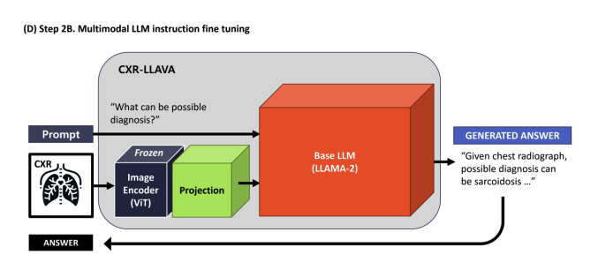
Goal: To refine the model's ability to handle complex questions and provide detailed answers about Chest X-Rays (CXRs).

Slide 18
They used refined radiology reports and question-answer pairs generated by GPT-4.Focused on:
Locations of anomalies (e.g., where the problem is).
Differential diagnoses (possible causes).
Recommendations (further imaging or studies).
The Projection Matrix (P) and the LLM were fine-tuned.

Slide 19
The final Model
The final CXR-LLAVA model takes a CXR image and question prompt as input. The image is transformed into an image token via the image encoder, and the prompt is converted to text tokens. Both are then fed into a causal language model, which generates text responses to the questions.
demo can be found at https://radiologist.app/cxrLLAVA.

Slide 20
Evaluation
1. Internal test set evaluation: They used a random sample of 3000 CXR images and reports from the MIMIC dataset as an internal test set. They used the CheXpert tool (extract label from text) to generate pathology labels from the model-generated reports and ground truth reports, and compared the labels to evaluate performance.
2. External test set evaluation: They used 3689 CXR images and reports from the Indiana University dataset as an external test set, using the same evaluation methodology as the internal test set.
3. Human radiologist evaluation: Three radiologists were shown 50 CXRs from the external test set and asked to rate the acceptability of the model-generated reports and ground truth reports. They reported the model to be acceptable.

Slide 21
Thank you
Questions?

